Slide 1
Lecture 9:
3.2.1. The Industrial Revolution I
Brad DeLong
Department of Economics and Blum Center, U.C. Berkeley; WCEG; and NBER
last revised: 2020-02-18
for presentation: 2020-02-20
Original course by Melissa Dell (Harvard Econ 1342), revised by Brad DeLong
<https://github.com/braddelong/public-files/blob/master/econ-135-lecture-9.pptx>

Slide 2
Roadmap for the Next Two Weeks
9. Industrial Revolutions I (Feb 20):
Read Before: Robert Allen (2017): The Industrial Revolution: A Very Short Introduction, chs. 3, 5-6 <https://delong.typepad.com/files/allen-industrial.pdf>
Slides: <https://github.com/braddelong/public-files/blob/master/econ-135-lecture-9.pptx>
Exam (Feb 25):
Instructor Reality Check
60% short answers; 40% essay
60 sample Qs <https://bcourses.berkeley.edu/courses/1487685/discussion_topics/5685922> | 30 with As <https://bcourses.berkeley.edu/courses/1487685/discussion_topics/5687341>
10. Industrial Revolutions II (Feb 27):
Read Before: Joel Mokyr (1990): Lever of Riches, chapter 5 “The Years of Miracles” <https://delong.typepad.com/files/mokyr-lever-revolution.pdf>
Read Before: Karl Marx and Friedrich Engels (1848): The Communist Manifesto <https://www.marxists.org/archive/marx/works/download/pdf/Manifesto.pdf>
Slides: <https://github.com/braddelong/public-files/blob/master/econ-135-lecture-10.pptx>
Start: Assignment 6: slow technological and organizational progress before 1500 paper; due Mar 4
11. Why Northwest Europe? (Mar 3):
Read: David Landes (2006): Why Europe and the West? Why Not China? <https://pubs.aeaweb.org/doi/pdfplus/10.1257/jep.20.2.3>
Slides: <https://github.com/braddelong/public-files/blob/master/econ-135-lecture-11.pptx>
Finish: Assignment 6: slow technological and organizational progress before 1500 paper; due Mar 4
9:40-9:42

Slide 3
Big Ideas: Lecture 8: Commercial Revolutions
Takeaways from last lecture:
Exploration & conquest
More resources for Europe due to Empire
Calories—sugar; Atlantic slave trade, underdevelopment of Africa
Silver: Europe then buys stuff from the rest of Europe
Poor world means… calorie shortage
“Commercial society”: luxury products & power centralization (gunpowder empires)
Adam Smith’s view of his world…
Columbian Exhange has benefits, big benefits, worldwide (save for west Africa & Africans, who really get the shaft here)
9:42-9:48

Slide 4
Preview of This Lecture 9: Industrial Revolutions I
What I hope we will cover:
Adam Smith had no clue of what was about to happen…,
Empire and commerce…
Coal…
“Institutions”
Science…
9:48-9:50

Slide 5
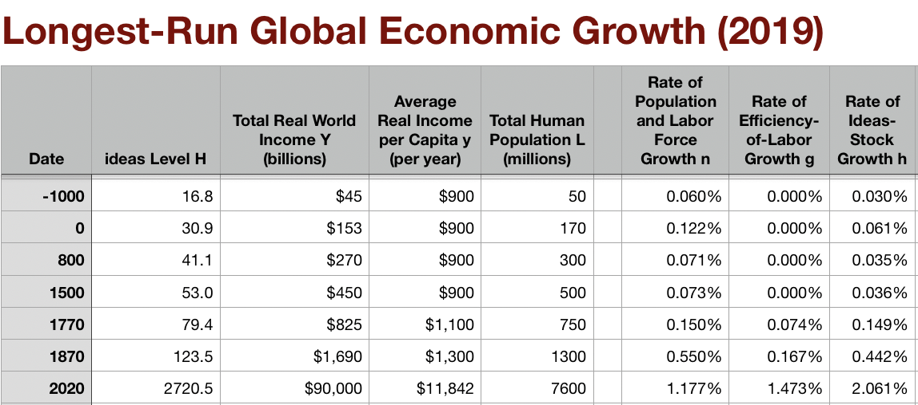
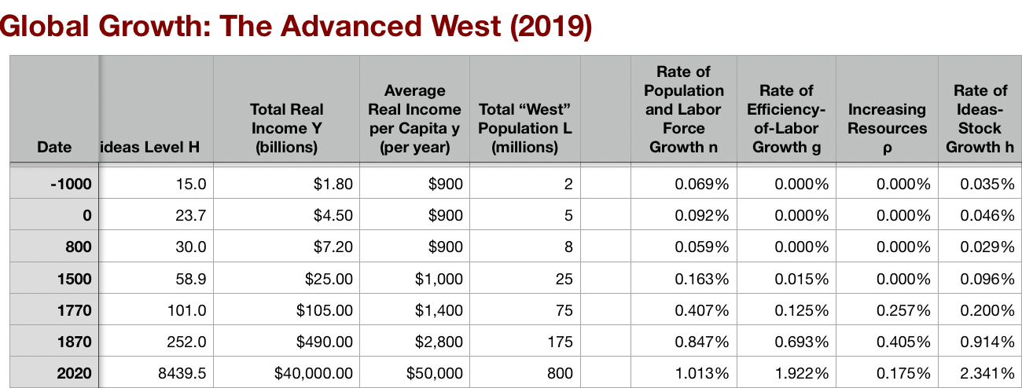
Adam Smith Had No Clue…
We have market economies throughout Eurasia, at least—i.e., places where becoming a merchant drawing on sophisticated artisanal producers is a road to wealth, even if not the road…
We have governments smart enough—or constrained enough—not to kill the goose that lays the golden eggs, at least not quickly…
We have what looks like worldwide growth at a faster pace after 1500—one that calls forth a demographic response…
Commercial Revolution sees shared global prosperity—but with Atlantic Europe grabbing the lion’s share primarily via empire…
Post-1770 in the North Atlantic we have growth that outruns any possible demographic response, and triggers the demographic transition…
Why? And how?
Post-1870 we have a further acceleration to modern economic growth…
9:50-10:00

Slide 6
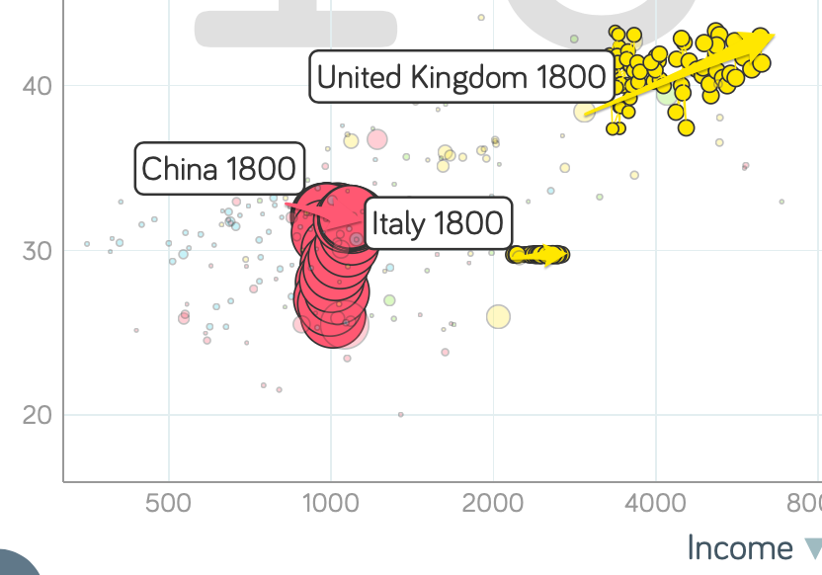
Global Divergence I
Before 1500: Marco Polo
From 1500-1650 Europeans traveling to the high civilizations of Asia reported:
The princes and merchants were fabulously rich…
The people were prosperous and orderly
From 1650-1750:
The princes and merchants were fabulously rich…
The people were orderly
After 1750:
The princes were fabulously rich…
The people were destitute…
https://www.gapminder.org/tools

Slide 7
Global Divergence II
Hans Rosling and Company: Gapminder Tools
1800-1870 sees:
UK go from $3430 to $6040
Italy go from $2220 to $2640
China go from $984 to $1100
From 1500-1700 Europeans traveling to the high civilizations of Asia reported general prosperity and order…
Not afterwards…
https://www.gapminder.org/tools

Slide 8
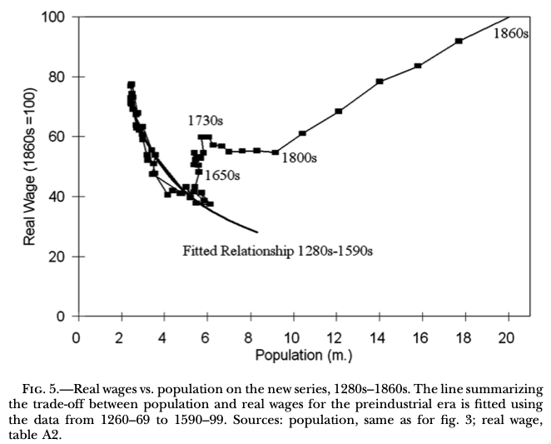
England Before 1800 Not Much Special
1265-1345: High Middle Ages…
1355-1475: Bubonic Plague and socio-economic aftermath…
1475-1595: Malthusian Demographic Recovery…
1595-1775: Profits of Atlantic Seaborne Empire…
1775-1845: Demographic explosion, with little or no trickle-down…
John Stuart Mill (1848 and 1871): “It is questionable if all the mechanical inventions yet made have lightened the day's toil of any human being. They have enabled a greater population to live the same life of drudgery and imprisonment…”
http://faculty.econ.ucdavis.edu/faculty/gclark/papers/secret2001.pdf

Slide 9
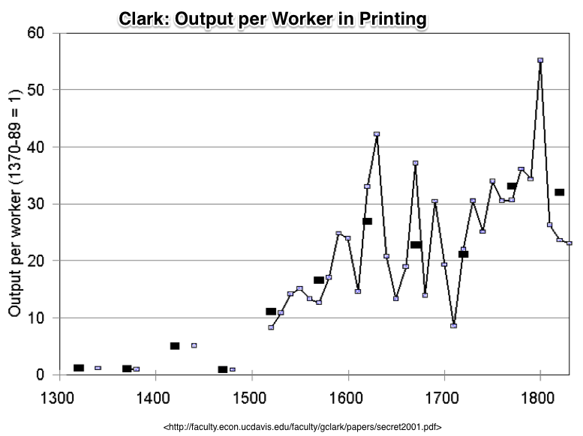
Compare to: Earlier “Industrial Revolution” in Printing Had No Direct Macro Impact…
A thirtyfold fall in the price of books from 1375 to 1775…
ln(30)/400 = 0.85%/year
But books are 1% of production…
So: 0.0085%/year
0.85%/century
3.4% over four centuries
That’s the direct effect…

Slide 10
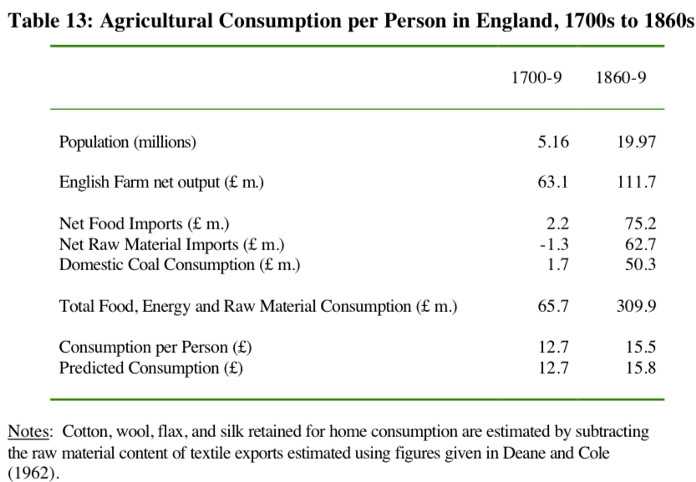
The Relocation of Global Industry to England
Clark: “The population fed and clothed by English agriculture did not expand from 7.5 million to 21 million between 1760 and 1860… from 7.5 to 9.6 million…”
Gets into the business of combining cotton, imported food, coal, and British and Irish workers to make the world’s textiles, iron, machines, and ‘protection’…
A huge shift…

Slide 11
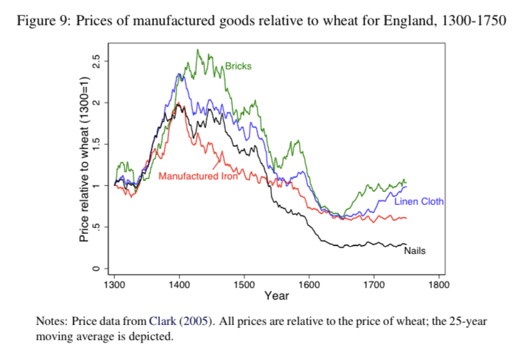
Huge Swings in Relative Price with Stable Technology

Slide 12
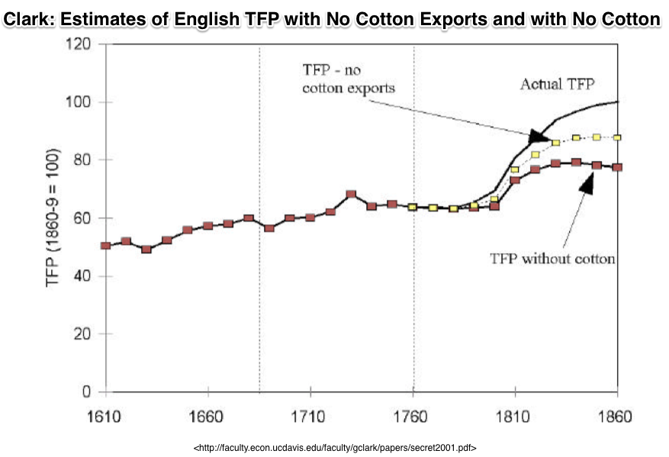
Cotton Is King! (Plus Iron and Steam)
The English ability to make clothes out of cotton in factories for domestic consumption was a 10%-of-everything gain by 1860…
The English ability to export cotton goods was another 10%-of-everything gain…
That’s 0.4%/year in a country growing its productivity level at 0.9%/year…
And iron and other steam are another 0.3%/year

Slide 13
Review: What Should We Review Today?
A number of possibilities:
The grand overview of the history of economic growth
10:00-10:10

Slide 14
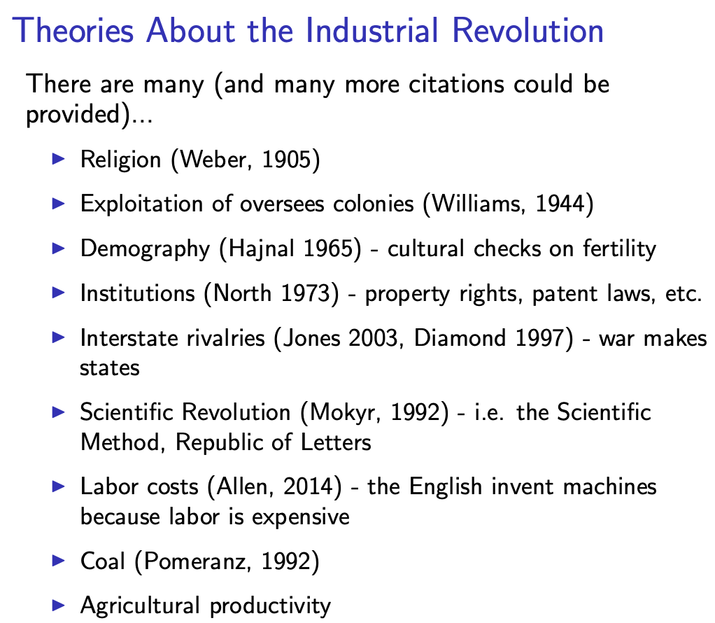
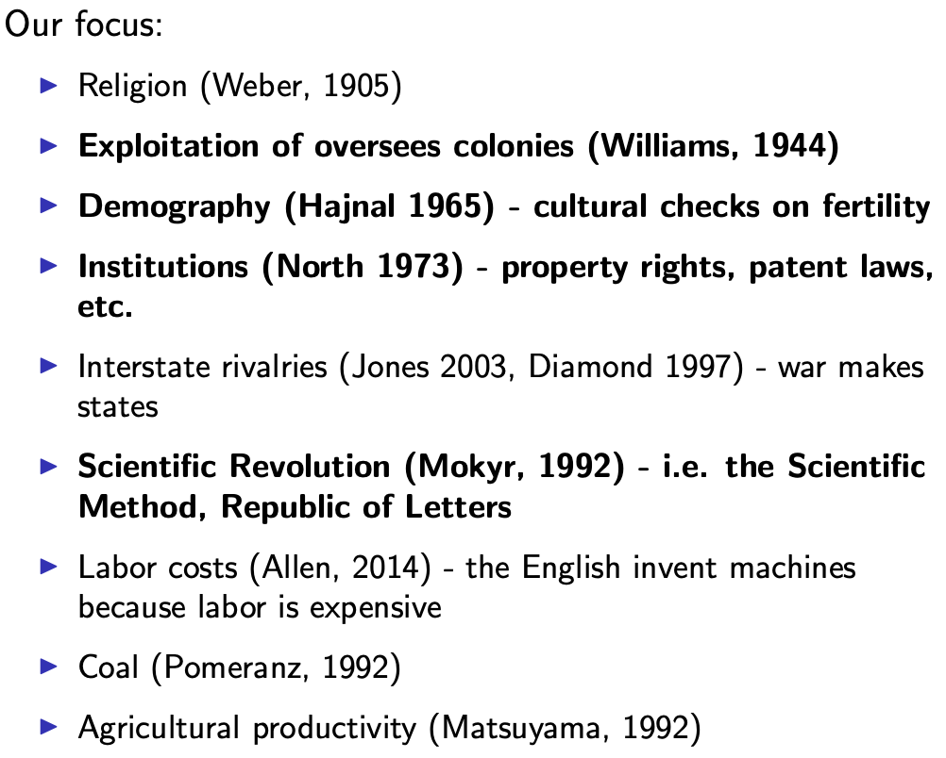
Many, Many Theories About the Industrial Revolution
Melissa Dell takes the “institutional” approach…
10:10-10:30
Slide taken from Melissa Dell

Slide 15
I Am Going to Take Allen’s Approach: Factor Prices & Empire
Robert Allen (2017): The Industrial Revolution: A Very Short Introduction <https://delong.typepad.com/files/allen-industrial.pdf>, chs. 3, 5-6:
Technological change is the motor that powers economic growth:
A technological revolution was at the heart of the Industrial Revolution
Abraham Darby’s successful smelting of pig iron with coke rather than charcoal in 1709…
Huntsman revolutionized the production of steel with the crucible process in the 1740s
Henry Cort did the same for wrought iron manufacture with the puddling and rolling processes in the 1780s.
James Hargreaves invented the spinning jenny in the 1760s
Richard Arkwright invented the water frame in the 1770s
Samuel Crompton invented the self-acting mule in the 1780s
Power weaving by Edmund Cartwright around 1785
The steam engine by Thomas Newcomen in the early 1700s
Steam engine improvement by James Watt in the 1760s
10:10-10:30

Slide 16
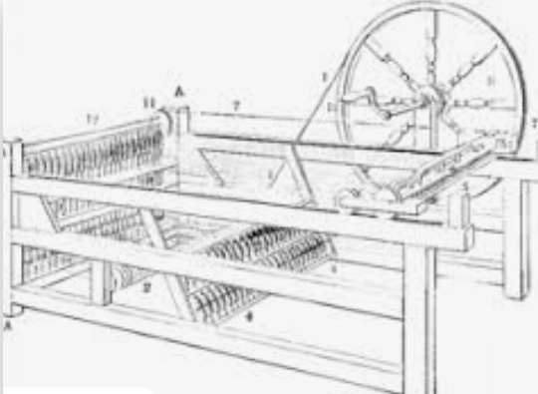
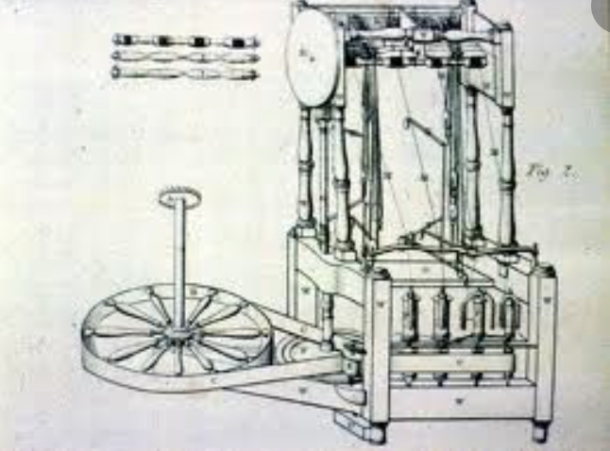
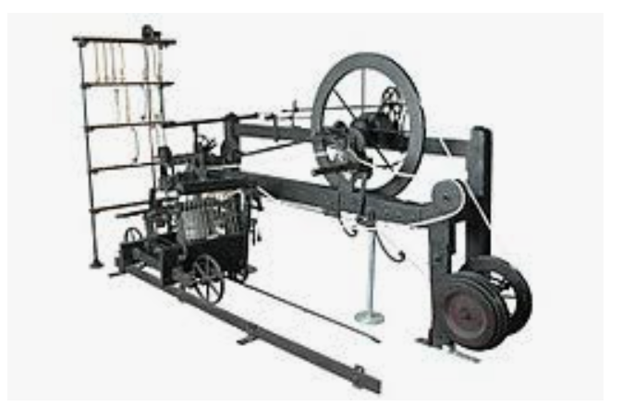
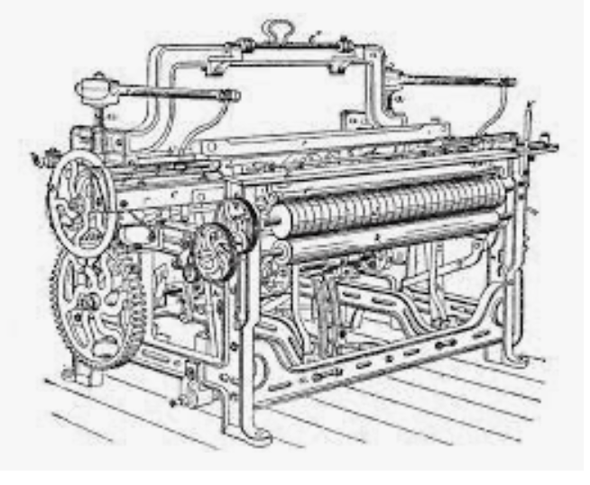
What Do These Look Like?
Spinning jenny, water frame, self-acting mule, Cartwright’s power loom:
10:10-10:30

Slide 17
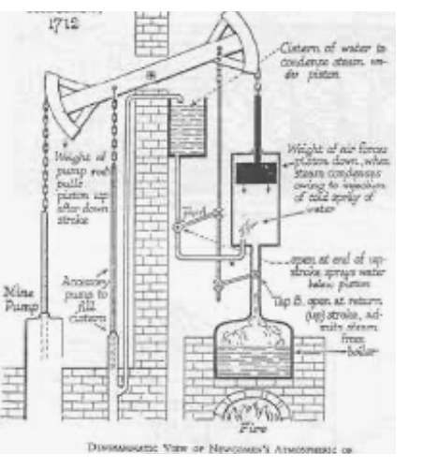
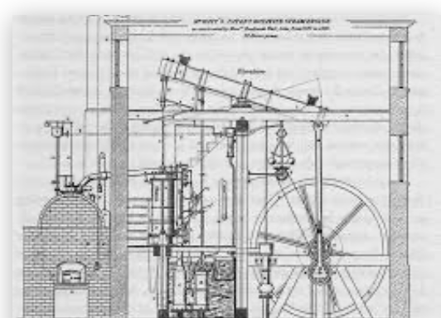
What Do These Look Like?
Newcomen and Watt
10:10-10:30

Slide 18
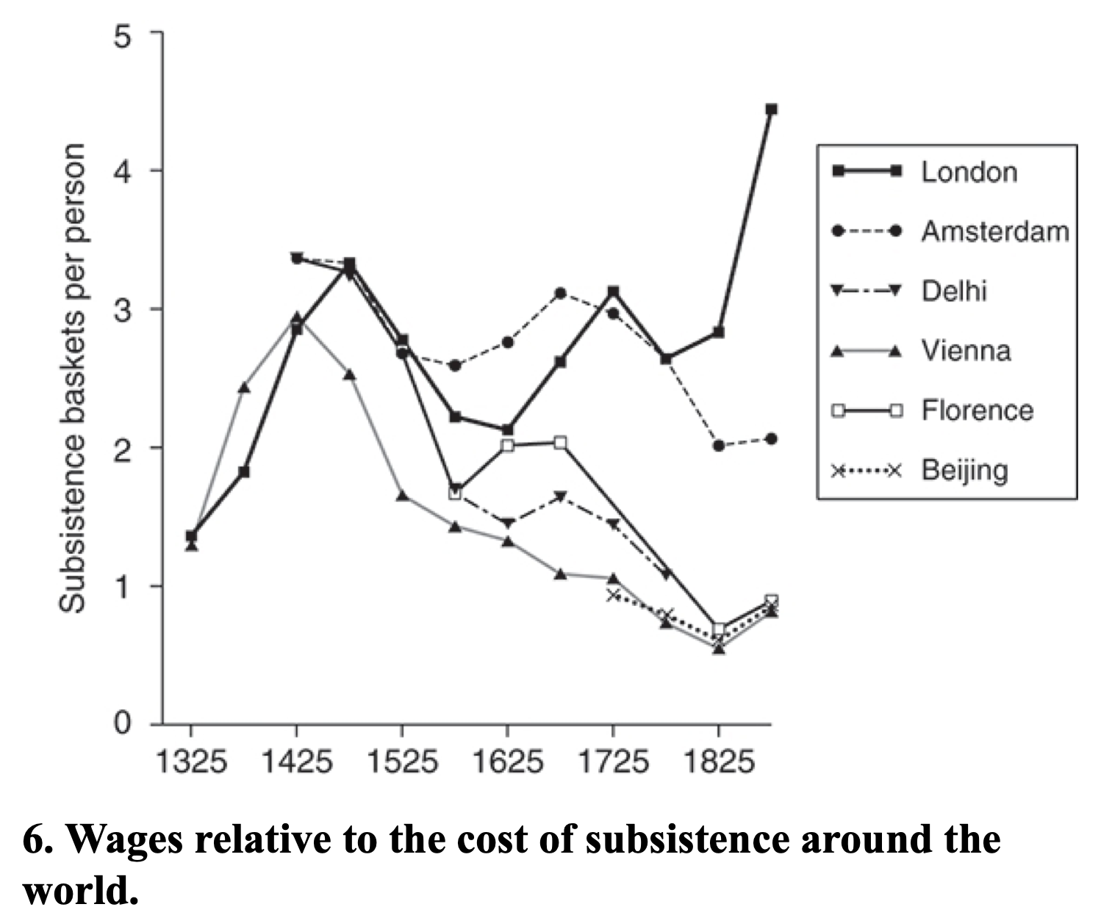
Background Factors
Allen (2017): “Institutions, practices, and culture that supported technological innovation and business investment, they were not sufficient on their own to explain the Industrial Revolution. Other parts of the world were equally blessed, but they did not have industrial revolutions…”:
Specific triggers…
Empire, commerce, and real wages…
Cotton—a fiber that could be worked by machine…
Factories…
Coal…
& steam engines…
10:10-10:30

Slide 19
Steam Engines
“The reason it was profitable to develop the Newcomen engine in Britain was because there were coal mines to be drained “:
The science underlying the steam engine was pan-European
The research and development (R&D) was carried out in Britain by an Englishman
James Watt, FRS: The Industrial Enlightenment
10:10-10:30

Slide 20
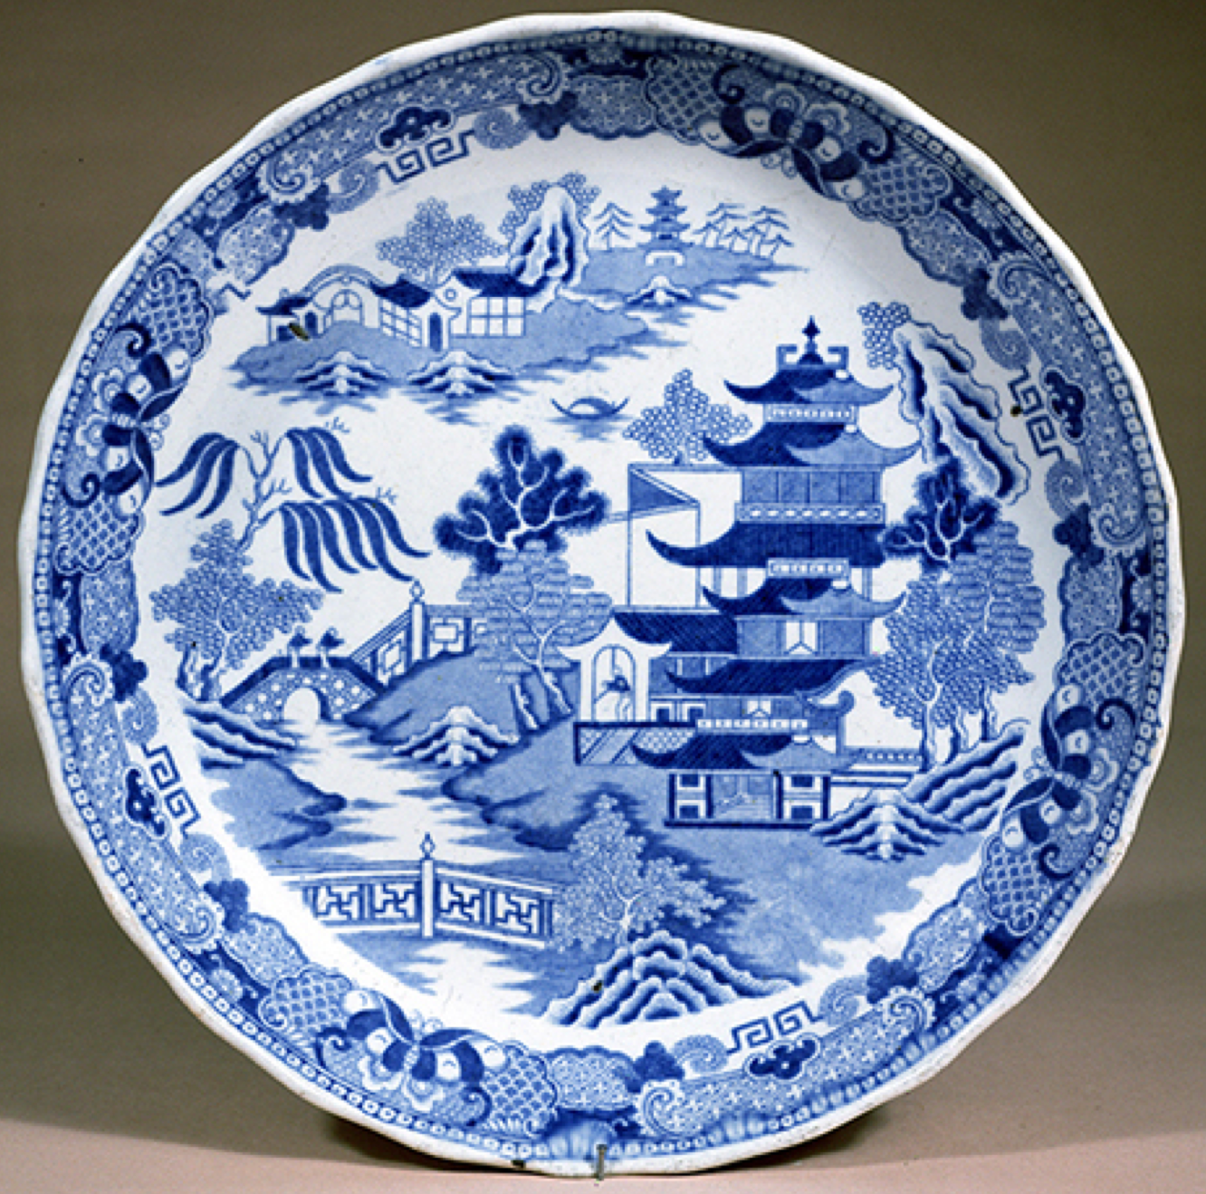
English vs. Chinese Pottery Kilns
Energy prices mattered—a lot:
England developed methods that differed fundamentally from those used in China. In both countries, technology evolved in the direction of reducing the use of expensive inputs while increasing the use of cheap ones…
English-style kilns had a coal fire in the bottom. The heat rose, enveloped the pots, and then vented out of the furnace through a hole in the top…
Chinese kilns used lots of capital to preserve energy. They consisted of a series of chambers rising up a hillside. A fire burned at the entrance to the lower chamber where the heat was drawn in to bake the pots. The heat was not vented out of a hole in the top in the English manner. Instead, it was forced down through a hole at floor level and entered the next chamber up the hill…
10:10-10:30

Slide 21
Steam Engines
165K HP in 1830, 2.1M HP in 1870:
1712: Newcomen: 5 HP
1733: 1K HP (100 engines)
1775: 9K HP (600 engines)
1800: 40K HP (500 Watt, 1500 Newcomen engines)
1830: 165K HP
1870: 2.1M HP
10:10-10:30

Slide 22
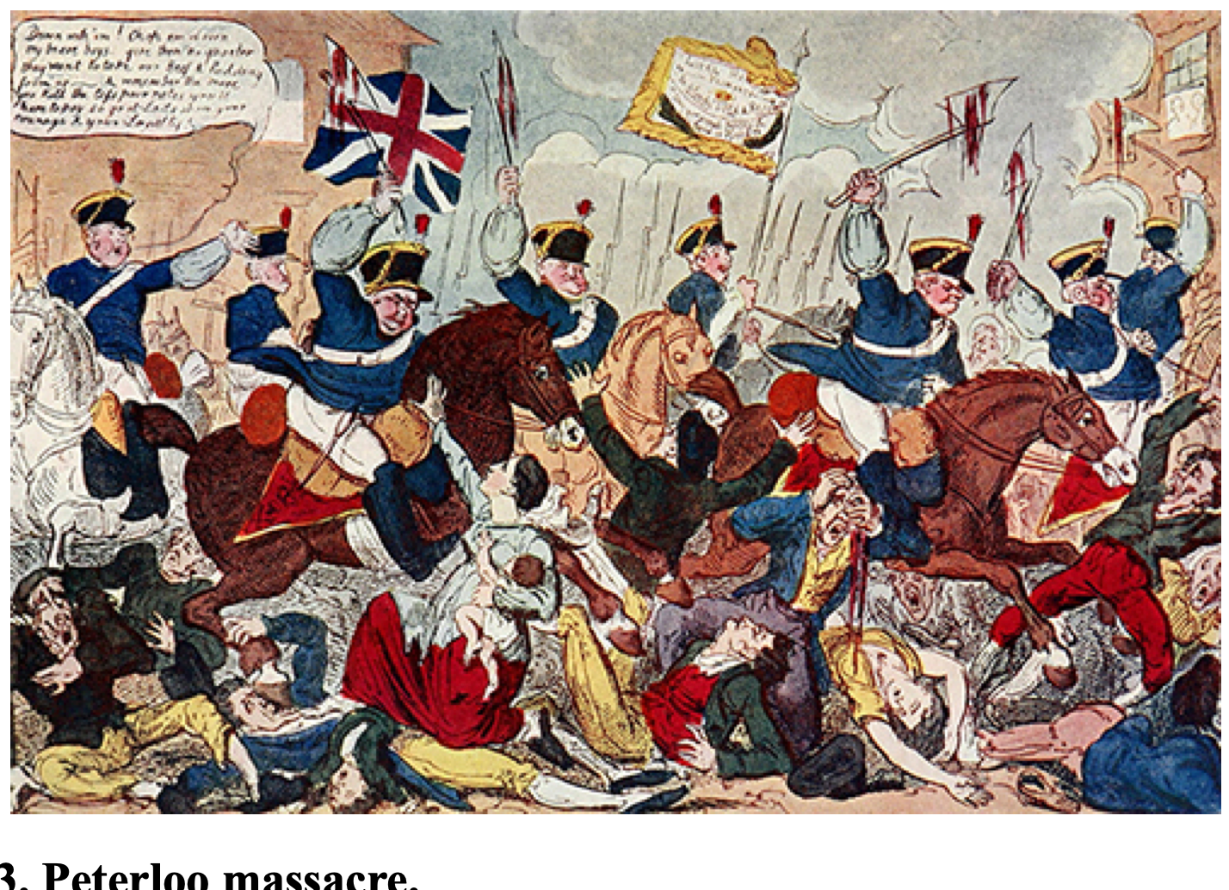
Allen: Reform and Democracy
Robert Allen (2017): The Industrial Revolution: A Very Short Introduction <https://delong.typepad.com/files/allen-industrial.pdf>, chs. 3, 5-6:
Enlightenment, literacy, pamphlets, The Rights of Man (sells 1 million copies), & the French Revolution
60,000-strong Manchester demonstration in 1819: eleven killed: “Peterloo”
“Reform that we may preserve”: 1832 Reform Bill
Virtual representation
Divide the reformers
1833: Factory Act—9-hour day for children under 12
1834: New Poor Law—workhouses
10:10-10:30

Slide 23
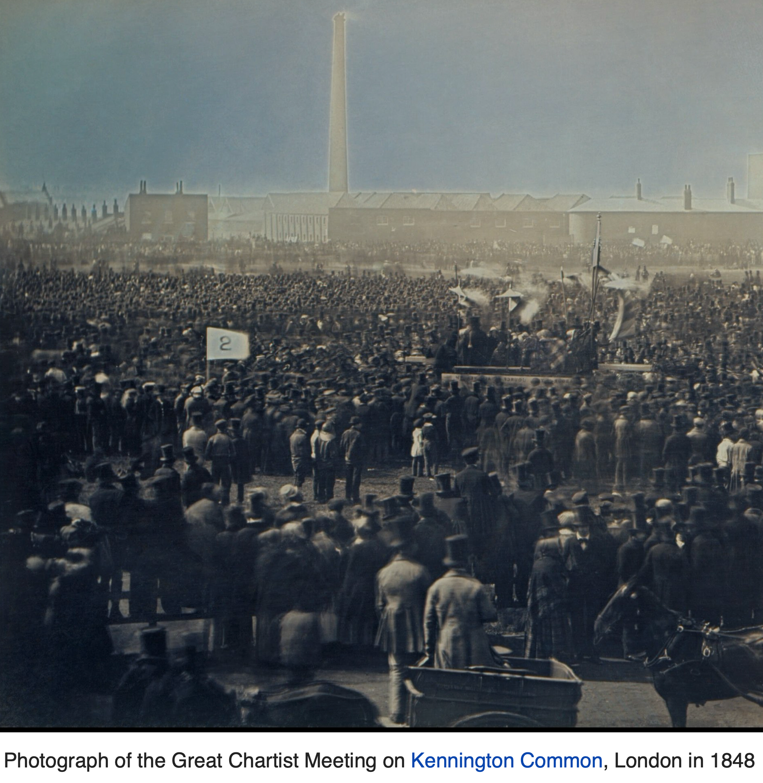
Allen: Reform and Democracy II
Robert Allen (2017): The Industrial Revolution: A Very Short Introduction <https://delong.typepad.com/files/allen-industrial.pdf>, chs. 3, 5-6:
1833: Factory Act—9-hour day for children under 12
1834: New Poor Law—workhouses
1838: People’s Charter
1846: Corn Law Repeal
The “condition of England”
John Stuart Mill (1848 and 1871): “It is questionable if all the mechanical inventions yet made have lightened the day's toil of any human being. They have enabled a greater population to live the same life of drudgery and imprisonment…”
1846-67: Real wage stagnation ends: average consumption per head in working class families rose by 42 per cent…
10:10-10:30

Slide 24
The People’s Charter
The People's Charter called for six reforms to make the political system more democratic:
A vote for every man twenty-one years of age, of sound mind, and not undergoing punishment for a crime.
The secret ballot to protect the elector in the exercise of his vote.
No property qualification for Members of Parliament in order to allow the constituencies to return the man of their choice.
Payment of Members, enabling tradesmen, working men, or other persons of modest means to leave or interrupt their livelihood to attend to the interests of the nation.
Equal constituencies, securing the same amount of representation for the same number of electors, instead of allowing less populous constituencies to have as much or more weight than larger ones.
Annual Parliamentary elections, thus presenting the most effectual check to bribery and intimidation, since no purse could buy a constituency under a system of universal manhood suffrage in each twelve-month period
10:10-10:30

Slide 25
Discussion
The Industrial Revolution:
Do we buy Allen’s “uniqueness” story?
Yes… perhaps…
Security of property overrated?
“Induced innovation”: first, but unique?
Gutenberg was not faced by high real wages…: technical curiosity has a logic of its own…
OK to be interested in production…
Epistemic learned helplessness…
believers in Allen…
players of the computer game Civilization are profoundly suspicious of Allen: they have seen the technology tree develop otherwise…
10:30-10:50

Slide 26
Big Ideas: Lecture 9: Industrial Revolution
Takeaways from this lecture:
OK: What should the takeaways from this lecture be?
10:50-10:55

Slide 27
Preview of Lecture 10: Industrial Revolutions II
What I hope we will cover:
SCIENCE!
Class and political economy
10:55-11:00

Slide 28
Catch Our Breath…
Ask a couple of questions?
Make a couple of comments?
Any more readings to recommend?

Slide 29
Notes

Slide 30
Reviews…

Slide 31
Review: Commercial Revolutions
Exploration and Conquest and Market Extension:
Zheng He: 1405-33: 7 expeditions—300 ships ??, 30,000 crew??, as far as Malindi. 400 feet long??:
“We have traversed more than 100,000 li of immense water spaces and have beheld in the ocean huge waves like mountains rising in the sky, and we have set eyes on barbarian regions far away hidden in a blue transparency of light vapors, while our sails, loftily unfurled like clouds day and night, continued their course [as rapidly] as a star, traversing those savage waves as if we were treading a public thoroughfare…”, quoted in Louise Levathes (1996): When China Ruled the Seas: The Treasure Fleet of the Dragon Throne, 1405–1433
Bartolomeu Dias: 1487-8: 3 ships, rounded the Cape of Good Hope at the southern tip of Africa. 80 feet long, 30 men/ship
Cristoforo Colombo: 1492: 3 ships, 90 men.
Vasco da Gama: 1498: 4 ships, 170 men to India and back
9:45-10:00

Slide 32
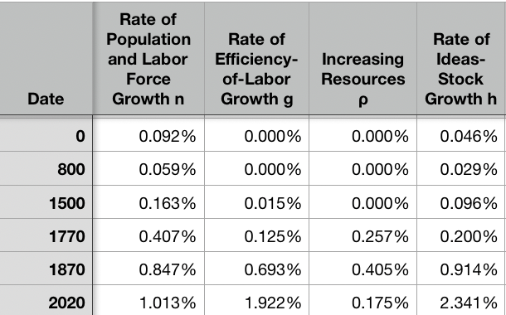
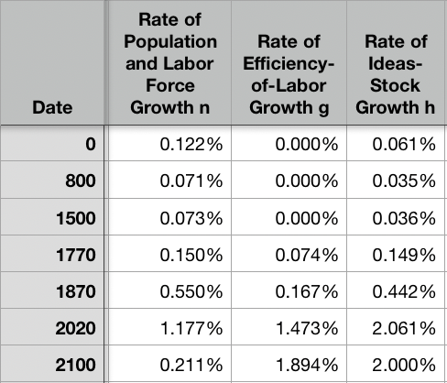
Resources! And Political Economy!
“The Advanced West”
The Columbian Exchange
Corn, the potato, chocolate, &c.: substantial boost to calories
Benefits everywhere!
But one-sided: Europe gains empire and resources wherever its ships can sail and cannon can shoot
Sugar islands and the slave trade
400 calories per Briton per day by 1750?
The underdevelopment of Africa
12.5 million Atlantic African slave trade
(2 million Mediterranean, 4 million Black Sea, 1 million Viking, 17 million Indian Ocean, 30 million Graeco-Roman)
The East Indies
Spices—later silks, porcelain, cottons: 80% fall in real price
Benefits everywhere
But benefits one-sided: disassembling a mountain of silver in Peru in order to import luxuries from China, India, Malaysia, and Indonesia…
Political Economy
The merchants of Bristol, the nabobs, the King of Spain: New wealth to add in to the scales…
Inflation
The World
9:45-10:00

Slide 33
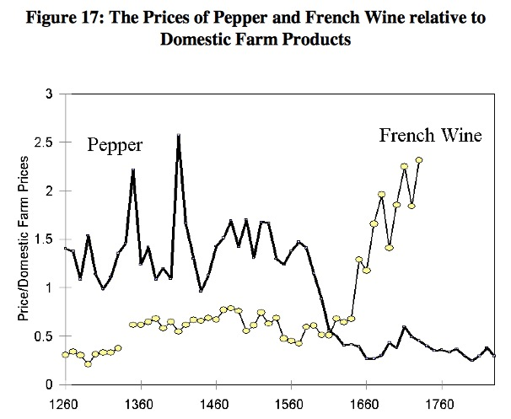
Clark, “The Secret History of the Industrial Revolution”
9:45-10:00

Slide 34
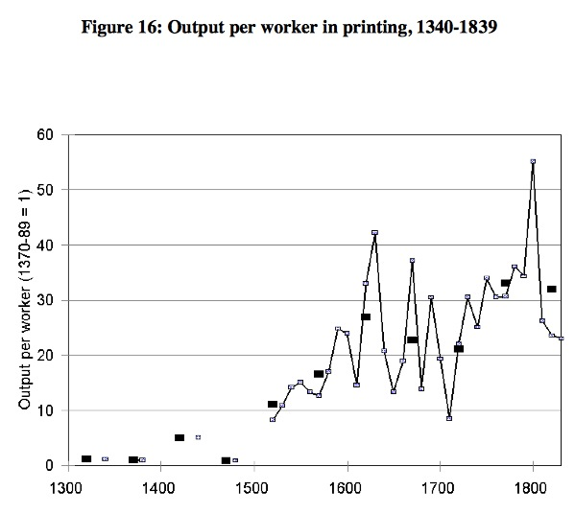
Clark, “The Secret History of the Industrial Revolution”
9:45-10:00

Slide 35
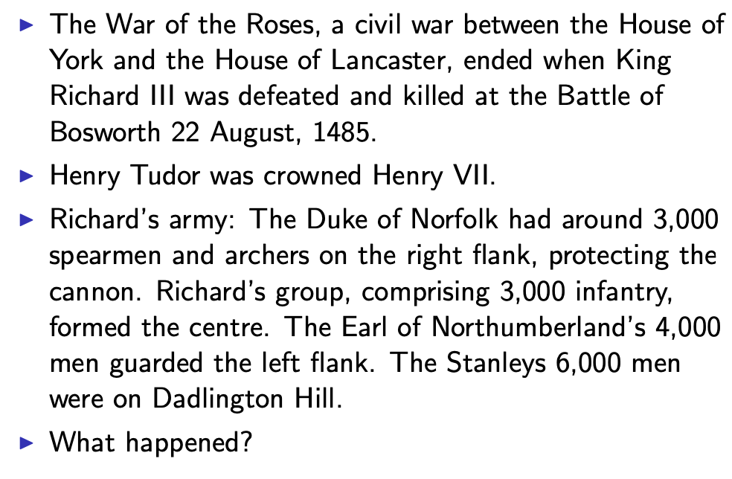
Establishing an Effective Monopoly of Violence: Wars of the Roses
10:10-10:20
Slide taken from Melissa Dell

Slide 36
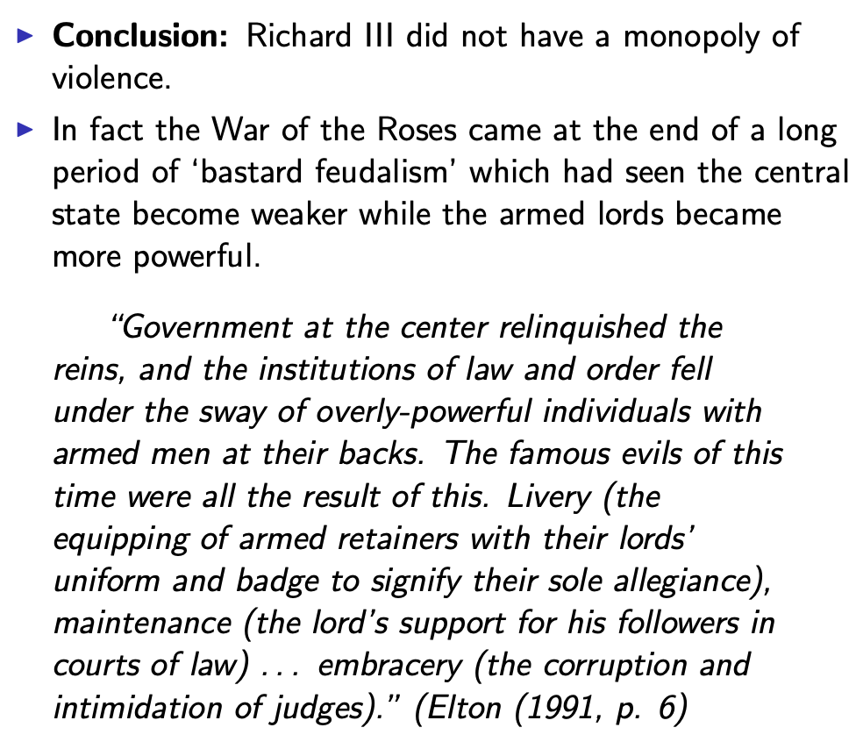
Establishing an Effective Monopoly of Violence: Implications of the Treason of the Stanleys
10:10-10:20
Slide taken from Melissa Dell

Slide 37
Marcher Lords: Warwick the Kingmaker
Adam Smith: “The great Earl of Warwick is said to have entertained every day, at his different manors, 30,000 people; and though the number here may have been exaggerated, it must, however, have been very great to admit of such exaggeration. A hospitality nearly of the same kind was exercised not many years ago in many different parts of the Highlands of Scotland…
10:10-10:20

Slide 38
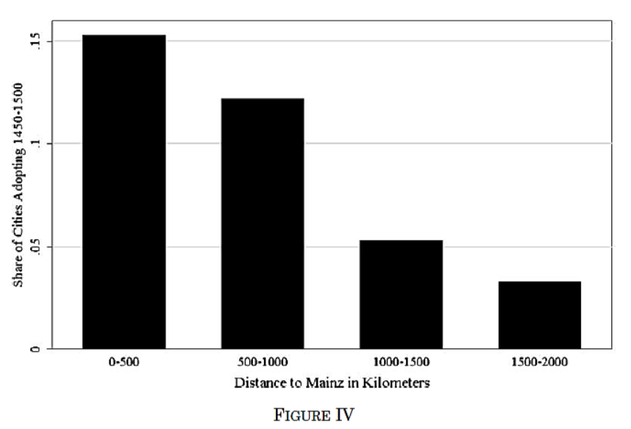
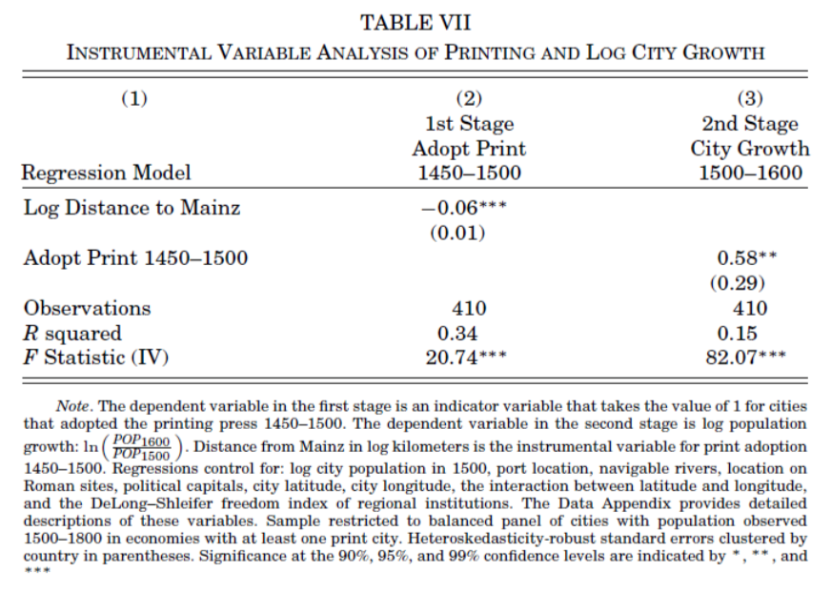
Jeremiah Dittmar (2011): The Printing Press as an Agent of Change… II
Dittmar’s Test: Compare (especially over the period 1500– 1600) population growth of cities that did and did not adopt the printing press before 1500.
Why are DIttmar’s IV estimates so big? 0.6 per century—a near doubling—as opposed to 0.2?
10:10-10:20

Slide 39
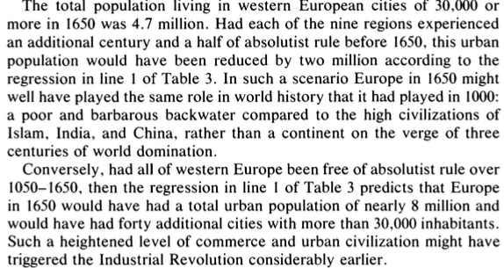
DeLong and Shleifer I
It’s a big deal…
10:10-10:20

Slide 40
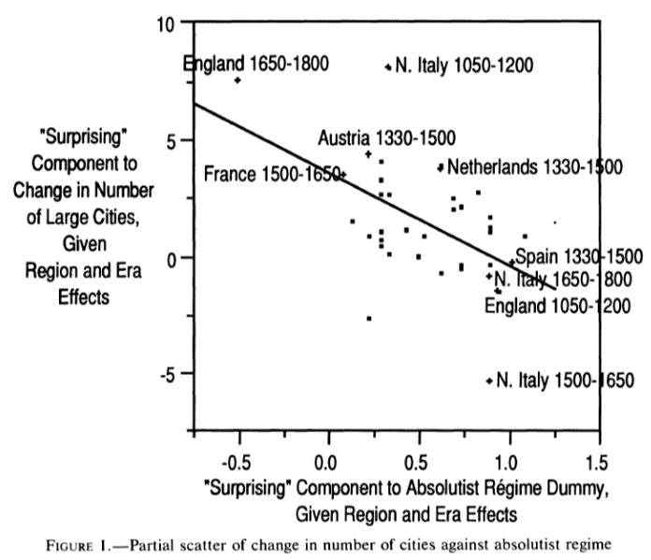
DeLong and Shleifer III
Northern Italy in 1500-1650 is “surprising” as absolutist then
England 1650-1800 is “surprising” as non-absolutist then
WTF?! with the Italian urban boom 1050-1200
Econometric problems
Normal distribution—we have only 45 observations, and 30 degrees of freedom…
The file-drawer problem…
10:10-10:20

Slide 41
Discussion
“Commercial Society” of the Eighteenth Century
An extra 1500 years of invention and innovation, yes…
Scope of control…
Columbian Exchange…
But, otherwise, how different from Antonine Rome or Sung China or Abbasid Mesopotamia?
It did occur in Antonine Rome…
Temin: no industrial revolution…
10:35-10:50

Slide 42
Review: Adam Smith
We Have a Very Keen-Eyed Contemporary Observer:
Read: Christopher Berry (2018): Adam Smith: A Very Short Introduction, chs. 1, 4-6 <https://delong.typepad.com/files/berry-smith.pdf>
The market economy as a game changer
Commercial society:
Hunter, shepherd, agricultural, and commercial stages…
“It is Smith’s explicit reference to a ‘commercial society’ that is distinctive and Smith here is a pioneer…”
Agrarian-Age power lies with the owners of land, and government is ‘a combination of the rich to oppress the poor’
Commercial society sees the growth of the rule of law—and a government that can enforce its property-rights order against local notables, roving bandits, and its own functionaries…
10:15-10:35

Slide 43
Why the Emergence of “Commercial Society”
Friedrich Engels:
“Exceptional periods, however, occur when the warring classes are so nearly equal in forces that the state power, as apparent mediator, acquires for the moment a certain independence in relation to both. This applies to the absolute monarchy of the seventeenth and eighteenth centuries, which balances the nobility and the bourgeoisie against one another; and to the Bonapartism of the First and particularly of the Second French Empire, which played off the proletariat against the bourgeoisie and the bourgeoisie against the proletariat. The latest achievement in this line, in which ruler and ruled look equally comic, is the new German Empire of the Bismarckian nation; here the capitalists and the workers are balanced against one another and both of them fleeced for the benefit of the decayed Prussian cabbage lords…” Origin of the Family…
It was in the kings’ and their bureaucracies’ interests—and they were (sometimes) able to make it stick.
10:15-10:35

Slide 44
Why the Emergence of “Commercial Society” II
Adam Smith, according to Berry:
“The feudal lords were masters… settled disputes, enforced discipline, and commanded their tenants to fight on their behalf….. [But] when foreign commerce introduced… what Smith deliberately calls frivolous and useless goods (he mentions diamond buckles) the lords sold off their land or granted long leases… undermine[d] their power to command and their ability to act as judges because those who had been previously dependent became independent: ‘For the gratification of the most childish, the meanest and the most sordid of all vanities’… these landlords gradually bartered away their whole power and authority (WN 419)…
“Smith calls this change a ‘revolution of the greatest importance to the publick happiness’ (WN 422)
But it was not brought about with the deliberate aim to further the public good…
It was, rather, an example of unintended consequences.
This made possible the ‘regular administration of justice’.
The establishment of that uniformity is crucial
Without it a commercial society is not possible
10:15-10:35

Slide 45
Once You Have the Preconditions for “Commercial Society”…
Commercial Revolution Prosperity:
“Universal opulence which extends itself to the lowest ranks of the people…”
Because of the division of labor…
Possible only in a well-governed society…
Berry: “Through the division of labour ten individuals could make 48,000 pins a day—equivalent to 4,800 each. But if each individual performed all the tasks required (drawing, straightening, cutting, pointing the wire, and so on) then less than twenty would have been manufactured. He gives three reasons for this: increased dexterity that comes from reducing each individual’s task to ‘one simple operation’; time-saving that stems from not having to transfer from one task to the next; and inventing better ways of executing the task prompted by the concentration on one task…”
Division of labor depends on the extent of the market…
And self-interest: “it is not from the benevolence of the butcher, the brewer or the baker that we expect our dinner, but from their regard to their own interest. We address ourselves not to their humanity but to their self- love and never talk to them of our own necessities but of their advantages. Nobody but a beggar chuses to depend chiefly upon the benevolence of his fellow-citizens…”
10:15-10:35

Slide 46

Smith’s “System of Natural Liberty”
Depends on Universal Principles: Smith according to Berry:
A ‘science of human nature’.
The self-interested hope of everyone to better their own condition.
The moral principle that everyone is free.
Individuals are the best judges of their own interests
The outcomes of particular exchanges redound unintentionally to the general benefit.
The ‘miserable poverty’ of the savage nations, as depicted in his Introduction, is left behind
The twin blessings of opulence and freedom are experienced.
10:15-10:35

Slide 47

Review: Why Was Pre-Industrial Progress so Slow on Average?
Our readings:
Willem M. Jongman (2007): Gibbon was Right: The Decline and Fall of the Roman Economy <https://delong.typepad.com/jongman-gibbon-was-right.pdf>
Peter Temin: The Roman Market Economy, Roman Growth <https://delong.typepad.com/files/temin-roman-growth.pdf>
Moses Finley: Technical Innovation and Economic Progress in the Ancient World <https://delong.typepad.com/finley-technical.pdf>
Josh Ober (2019): Agamemnon's Cluelessness, selections <https://delong.typepad.com/files/ober-agamemnon-selections.pdf>

Slide 48
Potential Points of View
What are the possibilities here?:
No puzzle—given how few heads they had, and given the absence of printing and the difficulty of controlled experiments, it is a miracle that they managed to advance technology as far as they did as fast as they did… (Kremer)
No: there was something wrong. They had the wrong kind of society… (Finley, critiqued by Ober)
No: something went wrong: civilization seems to be progressing up to the year 1… 0.013%/yr… 0.030%/yr… 0.061%/yr… & then it stalls out: instead of doubling to a Commercial Revolution rate of growth after the year 1, the rate of ideas growth halves again… (Jongman)

Slide 49
Our Four Readings
What possibilities do they argue for?:
Jongman:
“Population went down… production per man hour must have gone up…. The Roman Empire should have turned into a world of happy and prosperous peasants…. Reality was, of course, different… the emergence of a new social, political, and legal regime, where oppression replaces the entitlements of citizenship…”
Temin:
“The high ratio of wages to energy costs was not only absent in eighteenth-century continental Europe; it was absent as well in the Roman Empire…. There was no possibility of escaping from the Malthusian constraints… no possibility that industrialization could have begun in the ancient world…”
Finley:
“The pejorative judgments of ancient writers about labour, and specifically about the labour of the artisan, and of anyone who works for another, are too continuous, numerous, and unanimous, too wrapped up in discussions of every aspect of ancient life, to be dismissed as empty rhetoric. In other slave-owning societies for whom there is fuller documentation, these implications and their practical effects are unmistakable. Writing about the Great Trek, for example, Sir Keith Hancock said: 'The Boers very soon convinced themselves that artisans' work and slaves' work were the same thing—a conviction which struck such deep roots in their minds that their descendants in the nineteenth century left to British immigrants almost all the opportunities of skilled industrial employment in the expanding towns'. Or Tocqueville, whose I83I notebooks are filled with the theme that 'slavery is even more prejudicial to the masters than to the slaves', because, as a leading Louisville merchant said to him, 'it deprives us of the energy and spirit of enterprise that characterizes the States that have no slaves’…. Comparisons must be made with caution and reserve. But this particular one seems to me to be valid and necessary…”
Ober:
“Greeks were quite capable of the kind of reasoning necessary to build and sustain a growing economy…. Ancient Greeks, as individuals and collectives, frequently employed… rationally instrumental reasoning in economic contexts. It is nonetheless undeniable that there is a body of classical literature that exemplifies the scorn for money-making that was emphasized by the Finley school. Those expressions of scorn underpin the theory of an essentially timeless and changeless ancient economy predicated on violent extraction and gift exchange…. The approach of the Socratic philosophers to economic rationality was fundamentally critical and normative…. For Finley and his school… any activity that was not grounded in status, and in [its] power relations… was… unmoored and ephemeral…. Economic activity aimed at increasing productivity, innovations aimed at increasing efficiency, and increased consumption—rather than securing the status of the relevant actors—were, thereby, rendered more or less invisible—and in any event, unworthy of detailed study. The result was, so I suppose, both a misunderstanding of the relevant texts and a misrepresentation of the underlying social reality…”

Slide 50
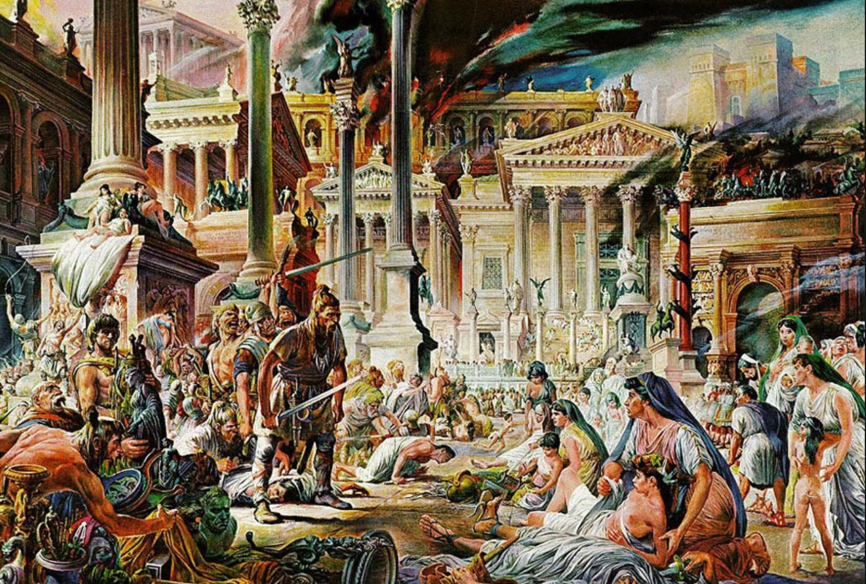


Review: The Fall of Rome
Economic Zenith, Then Economic Decline, Then Political Decline:
While the existing data are somewhat contradictory, the consensus amongst archaeologists is the early 2nd century.
A new social distinction between honestiores (high status) and humiliores (low status with different laws) was introduced.
Citizens began to lose their rights and by the end of the 2nd century, they were being tied to the land as serfs
The Barbarians were at the gates, but it seems reasonable to see this as an outcome of the weakening of Roman institutions
Earlier Rome had defeated far more formidable and better organized enemies like the Carthaginians.
Acemoglu and Robinson argue that the big fact about what preceded the decline is that political institutions moved in a much more extractive direction and this was followed by economic institutions.
Jongman (“Gibbon was Right”) proposes that the Antonine plague which hit the Roman Empire around 160AD is the most likely explanation for the collapse of Rome.
But Malthusian crises are supposed to increase living standards, not reduce them: so what is going on?
Slide taken from Melissa Dell

Slide 51
Three Great Plagues
But the demands of the empire for revenue and of the upper class for resources remain the same:
Antonine Plague (smallpox?): Antonine ⇒ Severian dynasty
Plague of St. Cyrian (Ebola-like?): Things fall completely apart, then Diocletian: between Philip the Arab and Diocletian, 18 emperors in 35 years, plus two breakaways; 12 of the 18 were assassinated
Plague of Justinian (Bubonic): Flavius Apion…

Slide 52
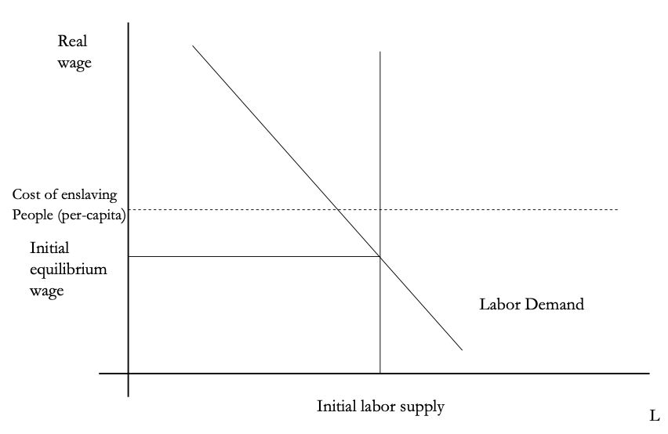
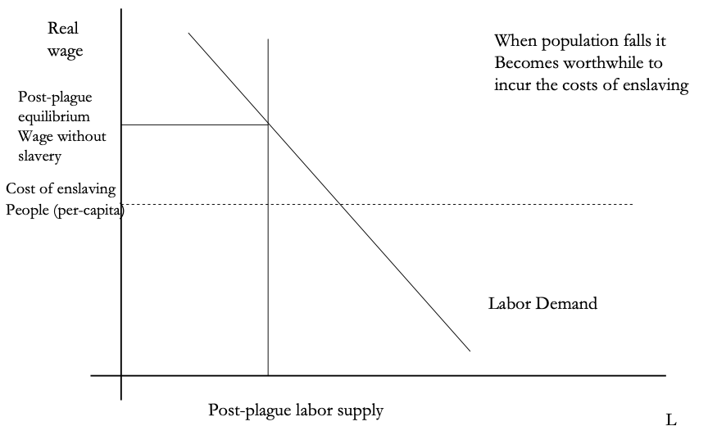
The Domar Hypothesis
You can have a leisured upper class, or abundant land relative to labor, or free labor, but not all three at once:
Slide taken from Melissa Dell

Slide 53
The Later Roman Empire
How does it compare to the expanding Roman Republic?
Militarism: in striking contrast to earlier days, a successful general is a threat to the emperor. Eighteen emperors in 35 years between Philip the Arab and Diocletian
Mobilization: In order to extract resources from a smaller population, the people must be disarmed rather than mobilized.
Distribution: The smaller pool of benefits needs to be hoarded for those with connections, not shared.
Incorporation: You can join the Goths: you cannot join the Roman upper class unless you know someone…

Slide 54
Dell’s Summary of Acemoglu and Robinson on the Rise and Fall of Rome II
For the Roman Empire, the collapse of Roman authority was pronounced, particularly in the West:
By 450AD all the trappings of Roman economic prosperity were gone.
Money vanished from circulation.
Urban areas were abandoned and buildings stripped of stone.
The roads were overgrown with weeds.
The only type of pottery which was fabricated was crude and hand made, not manufactured.
People forgot how to use mortar and they also forgot how to read and write.
Roofs were made of branches, not tiles.
The Eastern Roman Empire lived on, but it contracted significantly with the rise of Islam in the 7th Century.
Slide taken from Melissa Dell

Slide 55
Review: Republic to Empire
Political transition:
The expansion of Rome’s conquests created inequality and increasing political instability.
There were calls for the redistribution of land and power.
For example, Plebeian Tribune Tiberius Gracchus started to develop very ‘populist’ political platforms which threatened the senatorial elites.
The culmination of this was civil war, the dictatorship of Julius Caesar, and finally the creation of the Empire under Augustus.
First the principate
Then the dominate
Augustus reformed the army, removing it as a bastion of plebeian power.
His successor Tiberius stripped the assemblies of powers and gave them to the senate—and then neutered the senate
A semi-hereditary monarchy replaced the Republic:
“May good success attend the Roman senate and people and myself. I hereby adopt as my son Marcus Ulpius Nerva Traianus…”
This was a move towards more “extractive” political institutions and though it stabilized things for awhile, there was an eventual movement towards even more extractive economic institutions
Slide taken from Melissa Dell

Slide 56
Always Scribble, Scribble, Scribble! Eh! Mr. Gibbon?
Beste, Memorials:
The Duke of Gloucester, brother of King George III, permitted Mr. Gibbon to present to him the first volume of The History of the Decline and Fall of the Roman Empire. When the second volume of that work appeared, it was quite in order that it should be presented to His Royal Highness in like manner. The prince received the author with much good nature and affability, saying to him, as he laid the quarto on the table,
“Another damned thick, square book! Always, scribble, scribble, scribble! Eh! Mr. Gibbon?”

Slide 57
Always Scribble, Scribble, Scribble! Eh! Mr. Gibbon?
Five Good Emperors: Nerva-Trajan-Hadrian-Antonius Pius-Marcus Aurelius:
If a man were called to fix the period in the history of the world, during which the condition of the human race was most happy and prosperous, he would, without hesitation, name that which elapsed from the death of Domitian to the accession of Commodus.
The vast extent of the Roman empire was governed by absolute power, under the guidance of virtue and wisdom.
The armies were restrained by the firm but gentle hand of four successive emperors, whose characters and authority commanded involuntary respect.
The forms of the civil administration were carefully preserved by Nerva, Trajan, Hadrian, and the Antonines, who delighted in the image of liberty, and were pleased with considering themselves as the accountable ministers of the laws.
Such princes deserved the honor of restoring the republic, had the Romans of their days been capable of enjoying a rational freedom.
The labors of these monarchs were overpaid by
the immense reward that inseparably waited on their success;
by the honest pride of virtue, and
by the exquisite delight of beholding the general happiness of which they were the authors.

Slide 58
Aelius Aristides
The Roman Oration:
Whatever the seasons make grow and whatever countries and rivers and lakes and arts of Hellenes and non-Hellenes produce are brought from every land and sea, so that if one would look at all these things, he must needs behold them either by visiting the entire civilized world or by coming to this city. For whatever is grown and made among each people cannot fail to be here at all times and in abundance. And here the the merchant vessels come carrying these many products from all region in every season and even at every equinox, so that the city appears a kind of common emporium of the world.
Cargoes from India and, if you will, even from Arabia the Blest one can see in such numbers as to surmise that in those lands the trees will have been stripped bare and that the inhabitants of these lands, if they need anything, must come here and beg for a share of their own. Again one can see Babylonian garments and ornaments from the barbarian country beyond arriving in greater quantity and with more ease than if shippers from Naxos or from Cythnos, bearing something from those islands, had but to enter the port of Athens. Your farms are Egypt, Sicily and the civilized part of Africa.
Arrivals and departures by sea never cease, so that the wonder is not that the harbor has insufficient space for merchant vessels, but that even the sea has enough, if it really does.
And just as Hesiod said about the ends of the Ocean, that there is a common channel where all waters have one source and destination, so there is a common channel to Rome and all meet here, trade, shipping, agriculture, metallurgy, all the arts and crafts that are or ever have been, all the things that are engendered or or grow from the earth. And whatever one does not see here neither did nor does exist. And so it is not easy to which is greater, the superiority of this city in respect to the cities that now are or the superiority of this city respect to the empires that ever were…

Slide 59
Review: The Rise of Rome
Roman Institutions are key to the rise of Rome:
In 510BC, the citizens of Rome overthrew their king, Lucius Tarquinius Superbus, and created a republic.
The state was run by elected officials:
Two consuls who had the job for one year
Other magistrates: praetors, aediles, proconsuls
Tribunes.
Offices were elected, annual, and held by multiple people at the same time
This greatly reduced the ability of any one person to consolidate or exploit his power.
The institutions of the Republic contained a system of checks and balances which distributed power fairly widely.
Even if elite patrician families had far more power, it was possible for non-elites, so called plebeians, to get to the top, and they constrained the power of the elites.
Then some plebeian families become equally elite…
The nobiles
Roman assemblies:
Centuriate: 193 centuries on the basis of military organization, weighted toward the rich. Elects the magistrates, declares war and peace
Tribal: After 241 BC, 35 tribes on the basis of geographical location
Plebeian: Non-patricians, run by Tribunes
Senate
Roman institutions:
Legions
Phalanx
Manipular
Marian
Imperium
Provinciae
Proconsuls and propraetors
Slide taken from Melissa Dell

Slide 60
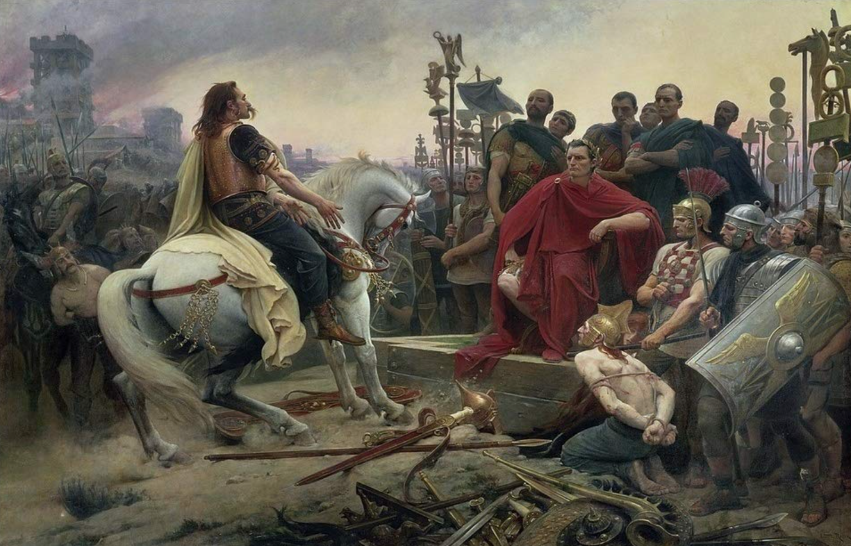
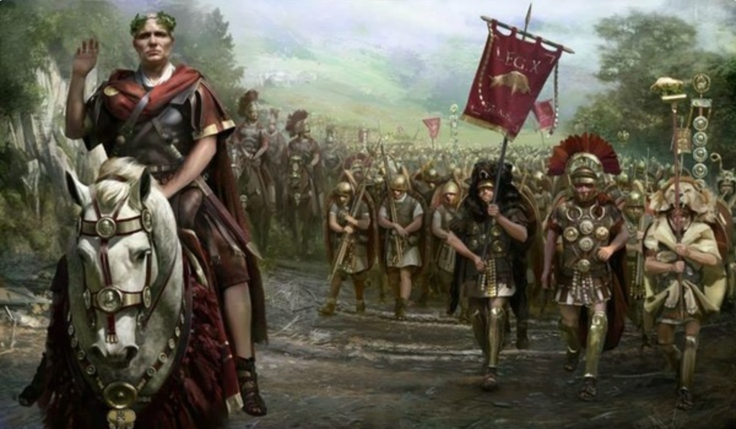
The Rise of Rome II
Roman Institutions are key to the rise of Rome:
Four key factors:
Militarism (on the part of elites competing for authority)
Mobilization (of the citizen mass)
Widely shared benefits (of conquest)
Incorporation (of conquered communities)
Mammoth military and political expansion after -340, and substantial economic, expansion
Slide taken from Melissa Dell

Slide 61
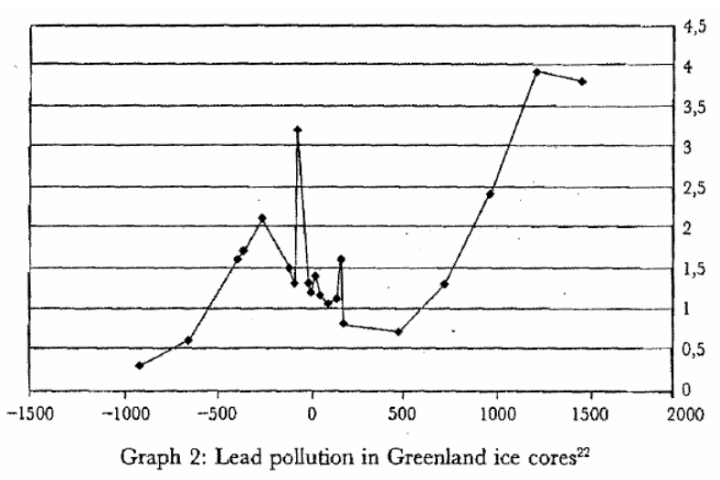
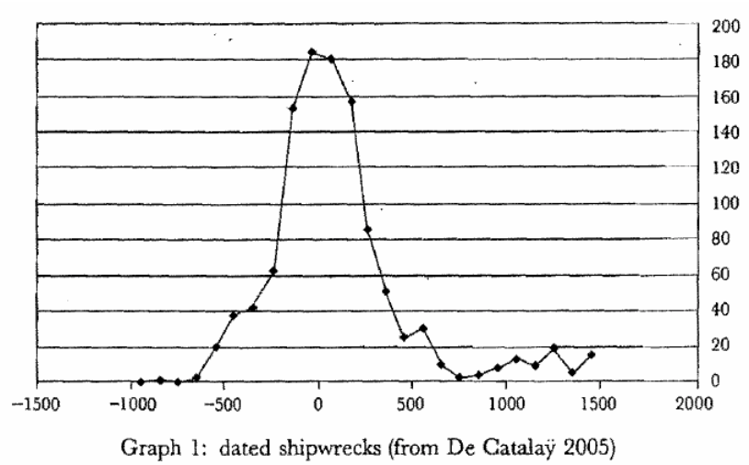
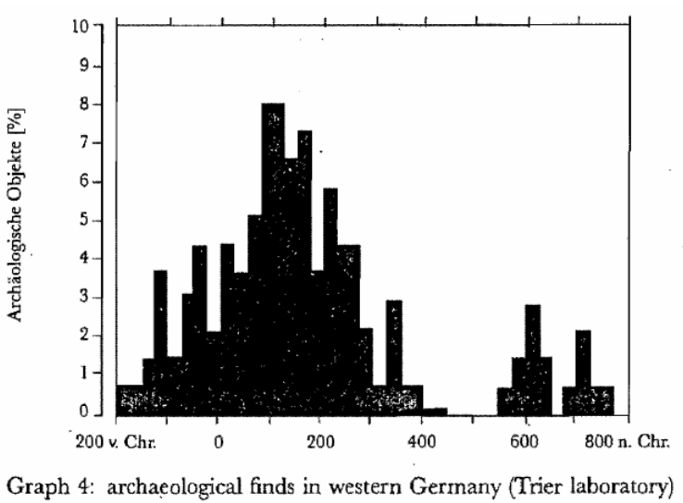
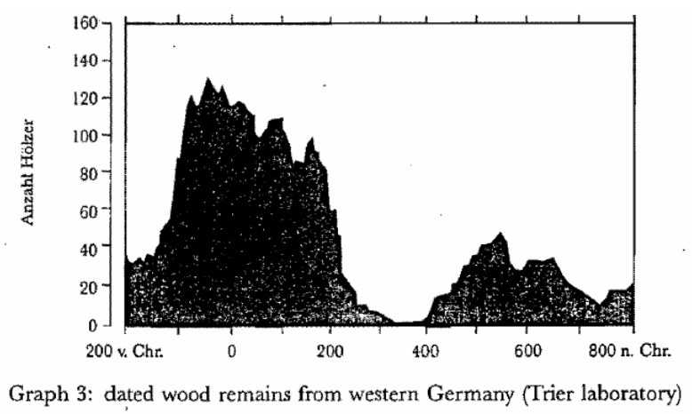

Measuring Roman Efflorescence
There are many interesting ways to track economic expansion:
Shipwrecks indicate trade, but they also track the movement of goods by fiat. For example, the citizens of Rome were kept happy by the free distribution of bread after 58BC. This was later extended to olive oil and even wine. This had to be shipped (mostly from Egypt and North Africa).
The Romans also moved around taxes levied in the provinces and supplied their troops. Some argue that 2/3 of all the ‘trade’ was actually the state moving stuff around.
For Roman citizens, economic institutions were quite good. However, the Italian economy was based on slavery (about 35% of the population of Italy were slaves at the time of the Emperor Augustus). There was little technological change.
Slide taken from Melissa Dell

Slide 62
Review: Pre-Industrial “Efflorescences”
Ideas courtesy of Jack Goldsmith, Daron Acemoglu and James Robinson:
The Malthusian model misses a great deal of the interesting action prior to the Industrial Revolution.
An alternative explanation for why there was no long-run trend in living standards is the theory of ‘efflorescence and decline’
I organize my thoughts about this with the two Malthusian equations, and with their bunch of variables and parameters: h, γ, β, φ, y^{sub}, s, δ, θ, and H that together determine y^{*mal} and L^{*mal}
This is best thought of as a filing system for factors that may be important—given the importance of both capital and labor efficiency, the roles of ideas and of resources in producing labor efficiency, and Malthusian population dynamics, these are the things you should look at

Slide 63
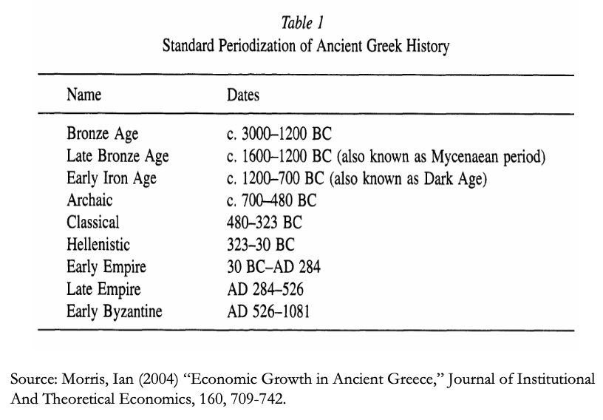
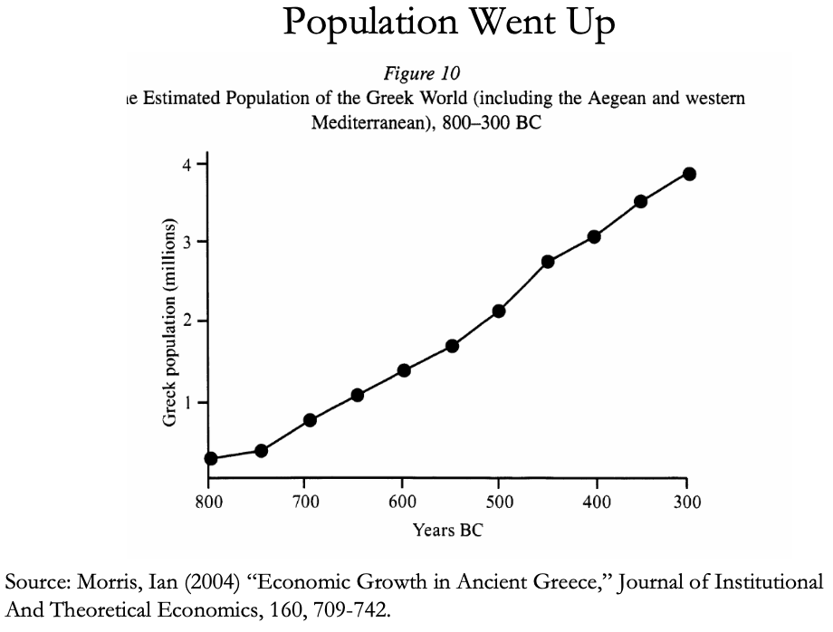
The Classical Greek Efflorescence
Emerging out of the Iron Dark Age of -1200 to -800:
When the Greek city states emerged they did so with functional systems of governance which provided public goods, such as security for trade and investment.
This initiated a period of sustained increases in living standards.
While Ancient Greece did have a period of democracy, it was relative short (less than 200 years) compared to the duration of the polity and most citizens - slaves, poor citizens who couldn’t afford their tax bill, women - could not participate.
Greek institutions (rules according to which the society was organized) tended to be “extractive.” For example, the economy was largely based upon slavery.
Slide taken from Melissa Dell

Slide 64
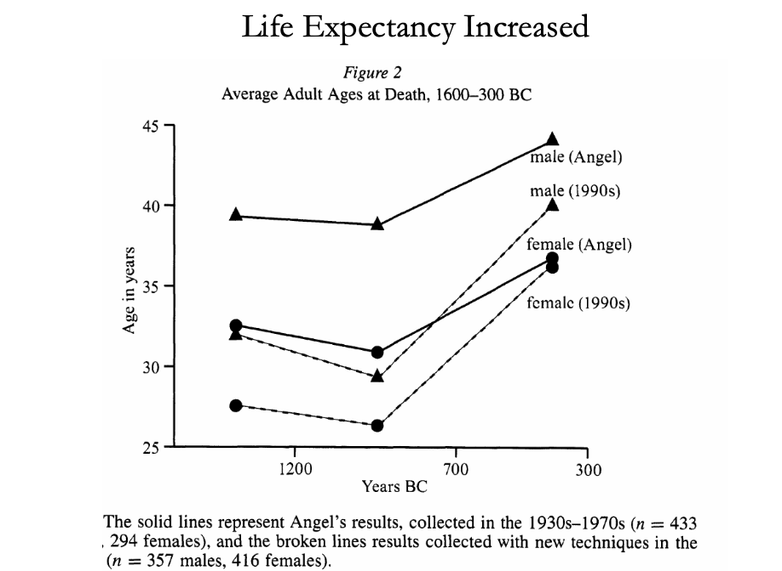
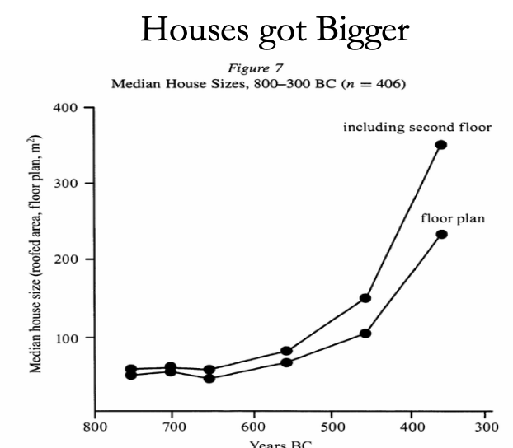
The Classical Greek Efflorescence II
“Developmental” or “Extractive”?
Extractive political institutions concentrate political power in the hands of some group who can use that power to redistribute wealth and income to themselves. This resulting concentration of wealth tends to reinforce the initial set of political institutions.
Roving bandits or stationary bandits?
Acemoglu and Robinson hypothesize that growth was not sustained in ancient societies because their institutions were extractive, and extractive institutions are incompatible with sustaining growth in the long run.
They argue that this is because extracting resources creates conflicts over who will control those resources, and it may also induce rebellion from below.
In either case political instability can bring the government and economy down.
Slide taken from Melissa Dell

Slide 65
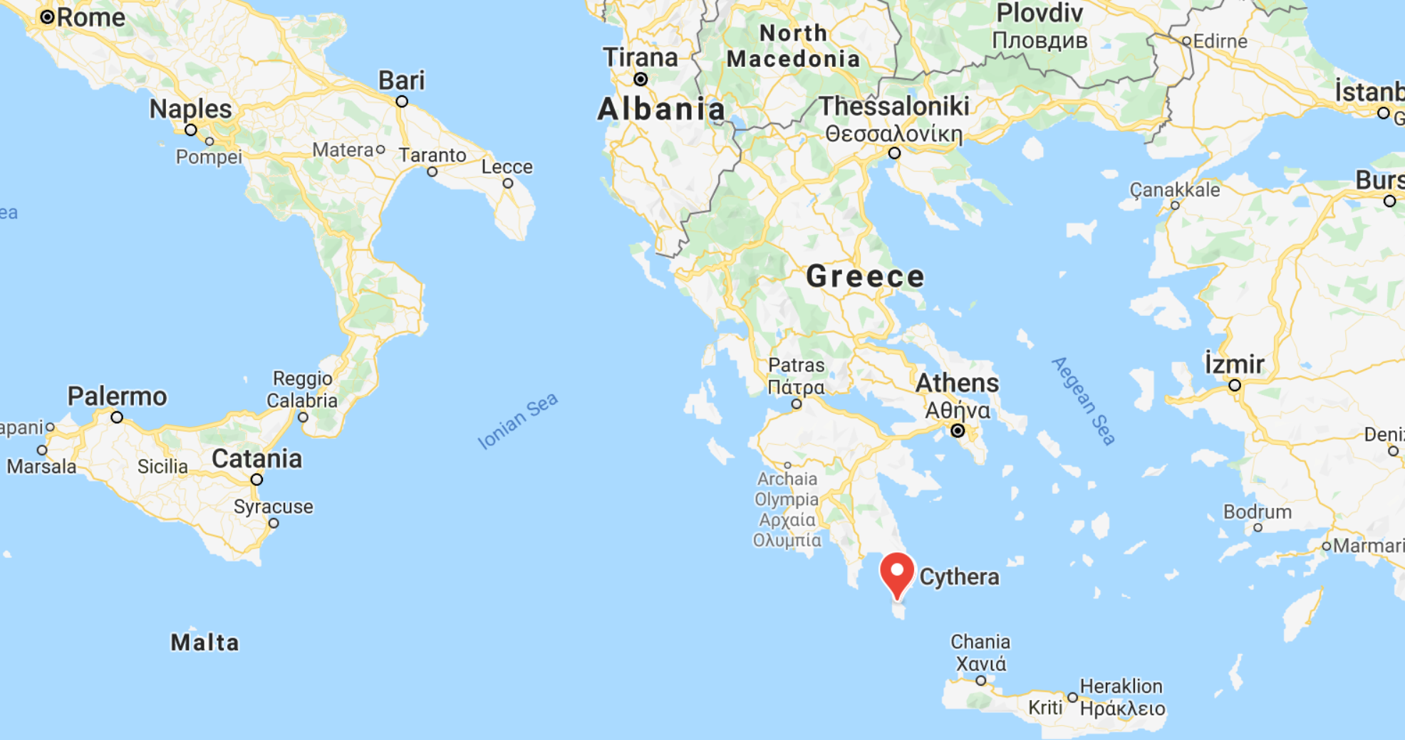
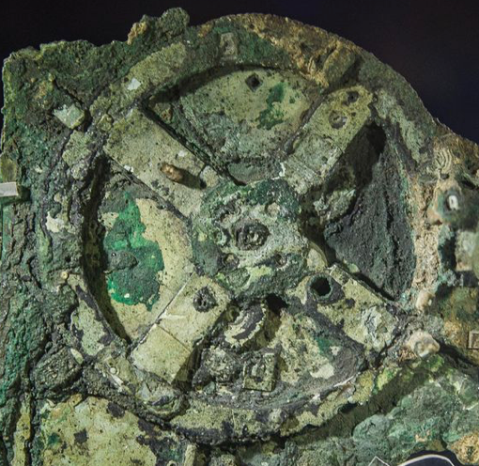
The Anti-Kythera Mechanism
What is this?
Built between -150 and -70. Rhodes13” x 7” x 4“ wooden box
Gears—largest 5” in diameter
Inscriptions
Wikipedia: “37 gear wheels enabling it to follow the movements of the Moon and the Sun through the zodiac, to predict eclipses and even to model the irregular orbit of the Moon, where the Moon's velocity is higher in its perigee than in its apogee. This motion was studied in the 2nd century BC by astronomer Hipparchus of Rhodes, and it is speculated that he may have been consulted in the machine's construction. The knowledge of this technology was lost at some point in antiquity. Similar technological works later appeared in the medieval Byzantine and Islamic worlds, but works with similar complexity did not appear again until the development of mechanical astronomical clocks in Europe in the fourteenth century…”

Slide 66
The Anti-Kythera Mechanism II
What is this?
Brian Resnick: “A main gear would move to represent the calendar year, and would, in turn, move many separate smaller gears to represent the motions of the planets, sun, and moon. So you could set the main gear to the calendar date and get approximations for where those celestial objects would be in the sky on that date…. You, as a user, could input a few simple variables and it would yield a flurry of complicated mathematical calculations.… All the user had to do was enter the main date on one gear, and through a series of subsequent gear turns, the mechanism could calculate things like the angle of the sun crossing the sky. (For some reference, mechanical calculators—which used gear ratios to add and subtract—didn’t arrive in Europe until the 1600s)…”

Slide 67
Cicero (-54): De Re Publica
“With the exception of the dream of Scipio, in the last book, the whole treatise was lost till the year 1822, when the librarian of the Vatican discovered a portion of them among the palimpsests in that library. What he discovered is translated here; but it is in a most imperfect and mutilated state. The form selected was that of a dialogue, in imitation of those of Plato…”
I.XIV:
Then Philus said: “I am not about to bring you anything new, or anything which has been thought over or discovered by me myself. But I recollect that Caius Sulpicius Gallus, who was a man of profound learning, as you are aware, when this same thing was reported to have taken place in his time, while he was staying in the house of Marcus Marcellus, who had been his colleague in the consulship, asked to see a celestial globe which Marcellus’s grandfather had saved after the capture of Syracuse from that magnificent and opulent city, without bringing to his own home any other memorial out of so great a booty; which I had often heard mentioned on account of the great fame of Archimedes; but its appearance, however, did not seem to me particularly striking. For that other is more elegant in form, and more generally known, which was made by the same Archimedes, and deposited by the same Marcellus in the Temple of Virtue at Rome.
“But as soon as Gallus had begun to explain, in a most scientific manner, the principle of this machine, I felt that the Sicilian geometrician must have possessed a genius superior to anything we usually conceive to belong to our nature. For Gallus assured us that that other solid and compact globe was a very ancient invention, and that the first model had been originally made by Thales of Miletus. That afterward Eudoxus of Cnidus, a disciple of Plato, had traced on its surface the stars that appear in the sky, and that many years subsequently, borrowing from Eudoxus this beautiful design and representation, Aratus had illustrated it in his verses, not by any science of astronomy, but by the ornament of poetic description. He added that the figure of the globe, which displayed the motions of the sun and moon, and the five planets, or wandering stars, could not be represented by the primitive solid globe; and that in this the invention of Archimedes was admirable, because he had calculated how a single revolution should maintain unequal and diversified progressions in dissimilar motions.
“In fact, when Gallus moved this globe, we observed that the moon succeeded the sun by as many turns of the wheel in the machine as days in the heavens. From whence it resulted that the progress of the sun was marked as in the heavens, and that the moon touched the point where she is obscured by the earth’s shadow at the instant the sun appears opposite….
Scipio: “I had myself a great affection for this Gallus, and I know that he was very much beloved and esteemed by my father Paulus. I recollect that when I was very young, when my father, as consul, commanded in Macedonia, and we were in the camp, our army was seized with a pious terror, because suddenly, in a clear night, the bright and full moon became eclipsed. And Gallus, who was then our lieutenant, the year before that in which he was elected consul, hesitated not, next morning, to state in the camp that it was no prodigy, and that the phenomenon which had then appeared would always appear at certain periods, when the sun was so placed that he could not affect the moon with his light…”

Slide 68
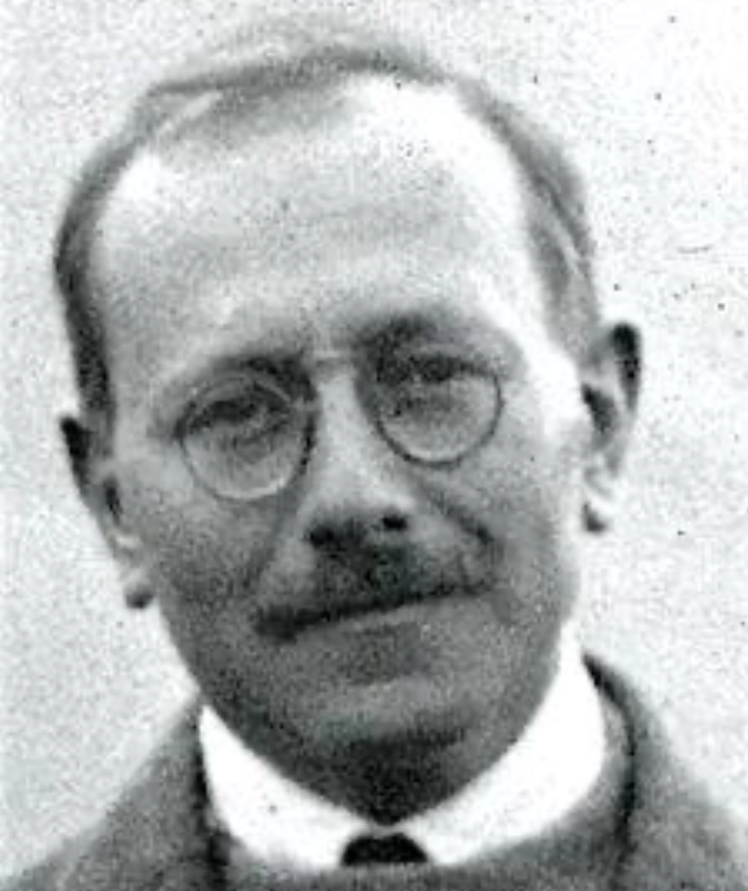
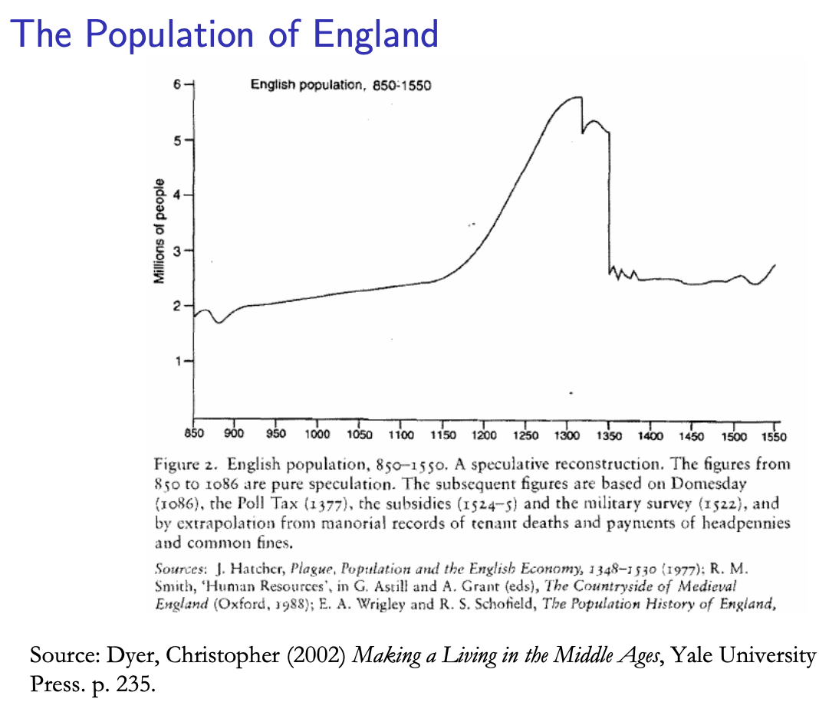
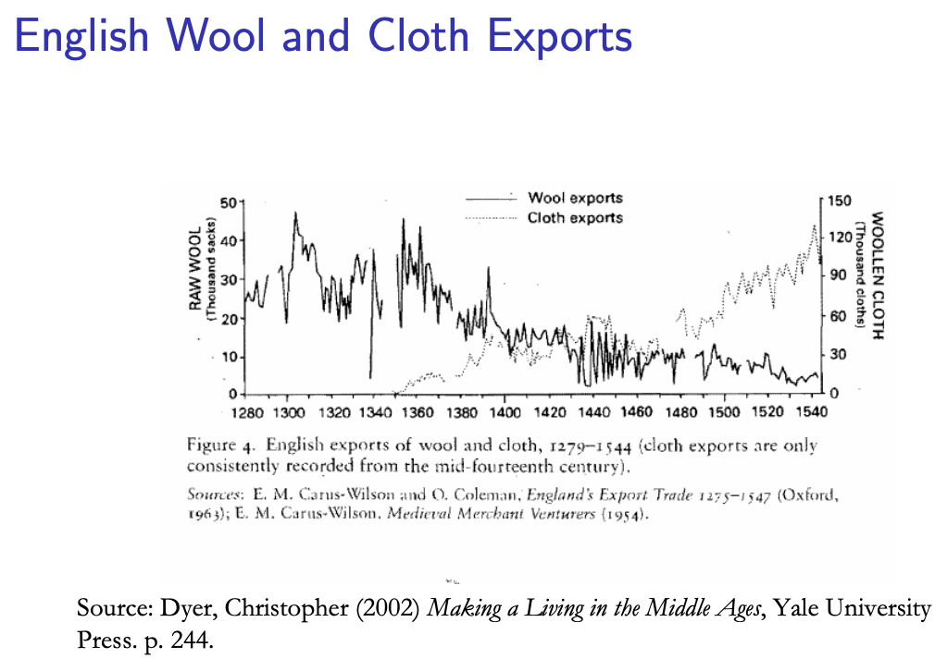
Review: Class and Conflict: at the End of the Middle Ages, Elsewhere, and Elsewhere
What was “feudalism” and how did it end?
Marc Bloch’s definitions:
A subject peasantry
Widespread use of the service tenement (i.e., the fief) instead of a salary (or of private property plus taxation and then purchase)
The supremacy of a caste of specialized warriors
Ties of obedience and protection which bind man to man
Within the warrior class, these ties assume the distinctive form called vassalage
Fragmentation of authority
Disorder and private war
But also, other forms of association, family, and state surviving…
By the late Middle Ages feudalism was a stable system
Trade and population expanded
What data we have shows the number and size of cities increasing
Slide taken from Melissa Dell

Slide 69
A Four-Cornered Fight
Kings, Lords, Commons, & Peasants:
Class alliances, class power, and class conflict…
Plus ideological legitimations…
Friedrich Engels: “Exceptional periods, however, occur when the warring classes are so nearly equal in forces that the state power, as apparent mediator, acquires for the moment a certain independence in relation to both. This applies to the absolute monarchy of the seventeenth and eighteenth centuries, which balances the nobility and the bourgeoisie against one another; and to the Bonapartism of the First and particularly of the Second French Empire, which played off the proletariat against the bourgeoisie and the bourgeoisie against the proletariat. The latest achievement in this line, in which ruler and ruled look equally comic, is the new German Empire of the Bismarckian nation; here the capitalists and the workers are balanced against one another and both of them fleeced for the benefit of the decayed Prussian cabbage Junker-squires…”
This is not just in exceptional periods…
The relative autonomy of the state is the rule, not the exception…

Slide 70
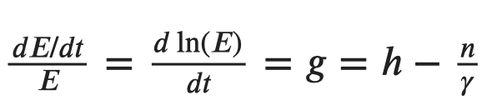
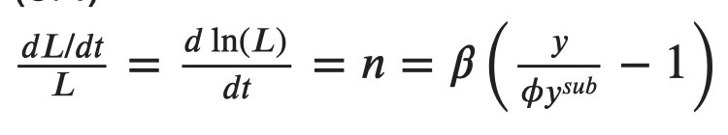

Review: Malthusian Models and Reality

Slide 71

Eastern Europe and the “Second Serfdom”
The percentage of people killed in Europe was similar across space:
After the plague, landlords in Eastern Europe started to take over large tracts of land and expand their holdings, which were already larger than those in Western Europe.
Towns were weaker and less populous and rather than becoming freer, workers began to see their already existing freedoms encroached on: the Domar hypothesis at work.
This contrasts with western Europe.
Effects became especially pronounced after 1500, when Western Europe began to demand the agricultural goods which the East produced.
Eastern landlords ratcheted up their control over the labor force to expand their production.
Mecklenberg: in 1500, peasants owed only a few days service a year; by 1600 this was three days/week; children had to work for the lord for free for several years.
In Hungary, landlords legislated one day a week of unpaid labor services for each worker. In 1550 this was raised to 2 days per week. By the end of the century it was 3 days. Serfs subject to these rules made up 90% of the rural population.
What was it that allowed the Spanish settlers in Mexico to keep wages so low, when in England after the Black Death the state had been incapable of enforcing the Statue of Laborers and stopping wages from rising?
William the Conqueror rewarded his army by providing them with parceled landholdings to prevent them from becoming powerful regional warlords (save for the “marcher lords” along the Scottish and Welsh borders).
Many landholders in close proximity created intense competitive pressures for labor in the wake of the Black Death.
Slide taken from Melissa Dell

Slide 72

Is Malthus Right? II
At the macro level, yes; but there are lots of interesting meso- and small-scale puzzles:
In addition, measures of good government, such as proxies for constraints on the executive, are correlated with urbanization in this period.
For example, DeLong and Shleifer (1993) showed there was a strong correlation between form of government and urbanization in the pre-modern world
Charles Wilson (1967): Trade, Society, and the State: "The two areas which in 1500 represented the richest and most advanced concentrations of trade, industry and wealth were the quadrilateral formed by the Italian cities Milan, Venice, Florence and Genoa; and the strip of the Netherlands that ran from Ypres north-east past Ghent and Bruges up to Antwerp. It was not merely coincidence that these were the areas where the tradesmen of the cities had been most successful in emancipating themselves from feudal interference and in keeping at bay the newer threat of more centralized political control offered by the new monarchies. In the fleeting intervals between the storms of politics and war, men here glimpsed the material advance that was possible when tradesmen were left in peace unflattered by the attentions of strategists who regarded their activities as the sinews of war…”
Slide taken from Melissa Dell

Slide 73
Malthus: Summing Up
On the broadest scale only:
The simple Malthusian model may indeed capture some realities.
If labor markets are competitive, population growth may indeed induce a decline in wages.
Or if there is a fixed amount of land and few opportunities for labor intensive cultivation systems, a population increase may lead to a decline in output per worker.
However, the reality is typically much more messy.
How wages respond to changes in income will depend on institutions.
Thus the overwhelming likelihood that institutional or cultural factors also shaped pre-modern growth
It was not simply being dictated by the Malthusian relationship between births, deaths, and income.
Slide taken from Melissa Dell

Slide 74
Review: “Subsistence”

Slide 75



“Bare-Bones”
From Clark & Allen:
"Manual workers”—70% of median, 50% of average income
In 1800: the English population in 1800 is a very rich pre-industrial population
70% of spending spent on food
30-40% grains
20% meat and dairy
“Bare-bones” subsistence
Cities: Malthus rules, but it takes centuries—and other things can and do happen

Slide 76




Review: Determinants of Technological and Organizational Progress
How do we make sense of the fact that technological and organizational progress was so slow back then and is so (relatively) rapid now?
Two heads are (almost) better than one
But that does not quite work
Add in additional drag from first picking low-hanging fruit
What causes the increase in Lstem?
What institutions make it profitable for nstem to be higher?
Plus:
Learning by doing
Productivity through embodiment
Technology transfer through contact

Slide 77
Review: Solow-Malthus Model Basics
How do we make sense of the fact that people were ingenious and inventive back before 1500, and yet standards of living did not increase?
Although population did increase—slowly
Other parts of the model
Balanced-growth equilibrium
Convergence to equilibrium
Lecture notes: <https://nbviewer.jupyter.org/github/braddelong/long-form-drafts/blob/master/solow-model-5-pre-industrial.ipynb>
datahub: <http://datahub.berkeley.edu/user-redirect/interact?account=braddelong&repo=long-form-drafts&branch=master&path=solow-model-5-pre-industrial.ipynb>

Slide 78
Understanding the Solow-Malthus Equilibrium: Population and Labor Force
Notes:

Slide 79
Understanding the Solow-Mathus Equilibrium: Prosperity
Notes:

Slide 80

Steady-State and Along the Transition Path
The fall of an empire:
<https://nbviewer.jupyter.org/github/braddelong/LS2019/blob/master/2019-10-14-Ancient_Economies.ipynb>
A decline in inequality, taste for luxuries, and taste for urban living: Δφ = -0.25
A decline in law-and-order that produces a sharp fall in the savings rate: Δs = -0.10

Slide 81






Review: Solow Model Basics
Lecture Notes: <https://www.bradford-delong.com/2020/01/lecture-notes-the-solow-growth-model-the-history-of-economic-growth-econ-135.html>

Slide 82

Solving the Model

Slide 83

Along the Balanced-Growth Path
Everything except κ—which is constant—grows at a constant proportional rate: either n, or g, or n+g;
Labor force L grows at n
Income per worker y and the efficiency of labor E grow at g
Total income Y and the capital stock K grow at n+g

Slide 84
Review: Long-Run Patterns: Global h, g, & n

Slide 85

Long-Run Patterns: “Western” h, g & n
Where does the “ρ” come from?
“Ghost acreage”—conquest and resource utilization (sugar islands, timberlands, cottonlands, etc.)
Cultural expansion—Australia, Canada, New Zealand, & U.S.; Spain & Italy & Scandinavia; plus Japan, Korea, Taiwan, Hong Kong, & Singapore

Slide 86

One Figure: A Great Divergence
10:20
From 1800 to 2018:
The dots start with a 3-1 spread in incomes and a 10-year spread in life expectancy.
All the arrows go up.
Some arrows—mostly those already to the right—go right fast.
Other arrows go right slowly.

Slide 87

China and India and America, 1800-1975
From 1800 to 1975:
Measured living standards and productivity levels improve fourteen-fold in the United States…
…& less than 30% in China & India…
…in spite of economic, transport, and cultural globalization…
This is crazy!
A “great divergence”
Not only were China & India relatively poor in 1800, they fell further behind thereafter

Slide 88

China and India and America, 1975–2018
From 1975-2018:
Measured living standards and productivity levels…
…54.9/25.9 = 2.12 in America…
…16.0/0.9 = 17.8 in China…
…6.9/1.2 = 5.8 in India…

Slide 89
Industrial Revolution: Coal and Wages
Robert C. Allen:Why the Industrial Revolution Was British
Britain had a unique wage and price structure in the eighteenth century, and that structure is a key to explaining the inventions of the industrial revolution.
British wages were very high by international standards, and energy was very cheap.
This configuration led British firms to invent technologies that substituted capital and energy for labour.
High wages also increased the supply of technology by enabling British people to acquire education and training.
Britain’s wage and price structure was the result of the country’s success in international trade, and that owed much to mercantilism and imperialism.
When technology was first invented, it was only profitable to use it in Britain.
Eventually it was improved enough that it became cost-effective abroad. When the ‘tipping point’ occurred, foreign countries adopted the technology in its most advanced form…”
10:00-10:10

Slide 90

“Subsistence Basket” Wages
But this is an input rather than an output to the process of generating modern economic growth…

Slide 91
Robert Allen: Rule, Brittania!
Britain had uniquely high real wages
Why? Northwest European marriage pattern?
Why? Yeoman smallholder legacy of the Bubonic Plague?
Why? The British navy and the British empire and the fiscal-military state?

Slide 92

Rule, Brittania! II
Britain—not London so much as Newcastle, and Manchester—had a uniquely cheap real price of energy
Why? Coal at the surface?
Why? Coal on navigable water?
Why? Wet coal mines?
Only in Britain would the first generation of steam engines be both (a) useful and (b) profitable
Eighteenth-century Lancashire the only escape from Malthusian agrarian poverty

Slide 93

Two Views of the British Industrial Revolution
Peter Temin. 1997, “Two Views of the British Industrial Revolution,” Journal of Economic History 57 (March), pp.63–82. www.jstor.org/stable/pdfplus/2951107.pdf . The Issue:

Slide 94

Two Views of the British Industrial Revolution
Peter Temin. 1997, “Two Views of the British Industrial Revolution,” Journal of Economic History 57 (March), pp.63–82. www.jstor.org/stable/pdfplus/2951107.pdf

Slide 95
Two Views of the British Industrial Revolution
“There was, as noted for exports in Table 4, little variation in the composition of British imports over the first half of the nineteenth century….
“Britain maintained a clear comparative advantage in a wide variety of manufacturing industries throughout the first half of the nineteenth century. They held their own in the face of the spectacular growth of cotton-textile exports during those years. There is no hint that these other commodities were being pushed off the list of exports by the growth of cotton exports….
“There is an exception that proves the rule… watches and clocks. As Landes noted in his book on that industry, the English clockmakers and watchmakers were falling behind their continental competitors in the nineteenth century. Productivity stagnated in this industry, and it had become an import industry by midcentury.
“The export of most other manufactures, however, was continuing merrily along. The lesson of the constant rank order of these exports is that the various industries were keeping pace with each other…”

Slide 96
Two Views of the British Industrial Revolution
Temin seeks to investigate whether the “narrow front“ coal and steam and textiles and iron interpretation of the British Industrial Revolution fits the historical facts better or worse than the “broad front“ innovative society and economy interpretation.
Temin aims to use the Ricardian theory of trade and revealed comparative advantage To shed insights into changes in industry-level productivity over the course of the Industrial Revolution.
He finds essentially no change in the set of commodities that Britain exports and imports across the Industrial Revolution.
He claims that this decisively answers the question in favor of the “broad front” interpretation.

Slide 97
Two Views of the British Industrial Revolution
Why might he be wrong?

Slide 98
Two Views of the British Industrial Revolution
Why might he be wrong?
Capital outflows…
Improvements abroad in agriculture etc.
Changes in relative prices…
Especially cotton...

Slide 99

Two Views of the British Industrial Revolution

Slide 100

Two Views of the British Industrial Revolution

Slide 101

Two Views of the British Industrial Revolution

